Slide 1



bit.ly/ionkerul
Ionic5 T01 Intro
ILP Selandar

Slide 2


Slide 3
OVERVIEW
TO IONIC FRAMEWORK

Slide 4

What is Ionic?
Ionic Framework is an open source UI toolkit for building performant, high-quality mobile and desktop apps using web technologies (HTML, CSS, and JavaScript).

Slide 5
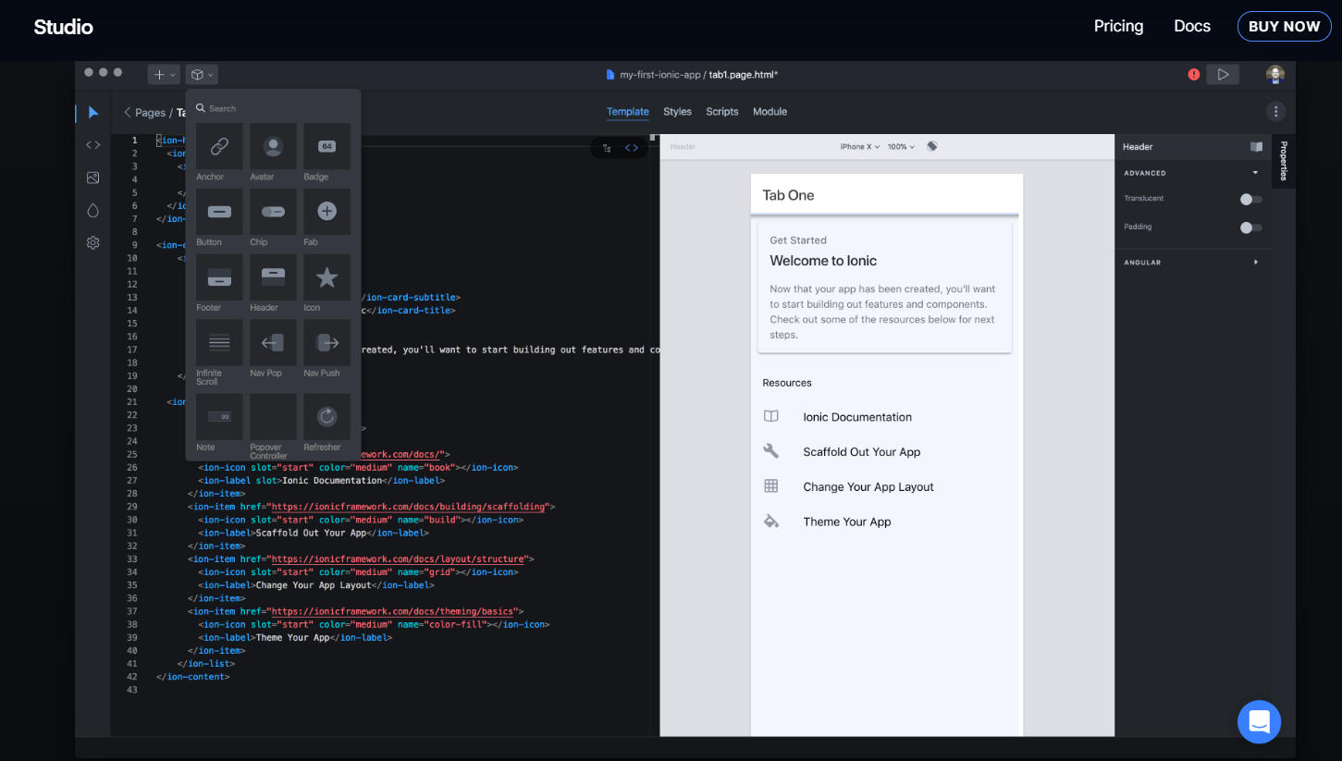
Ionic Studio

Slide 6
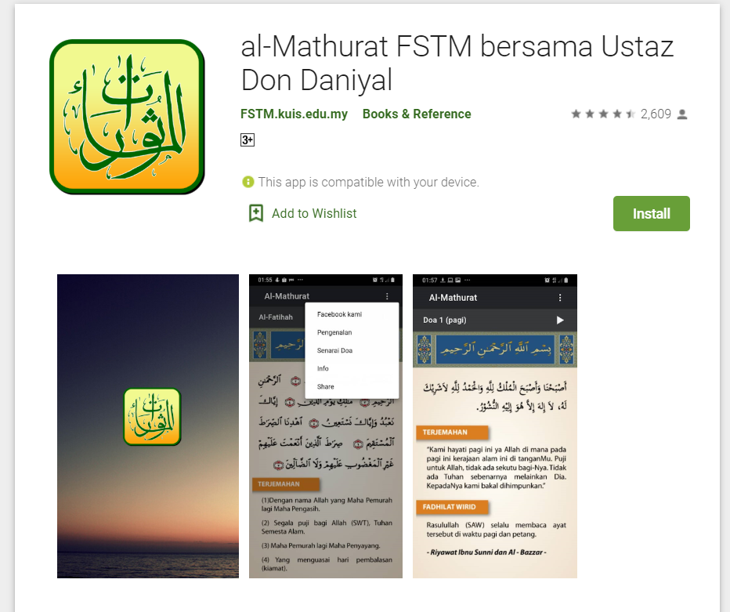
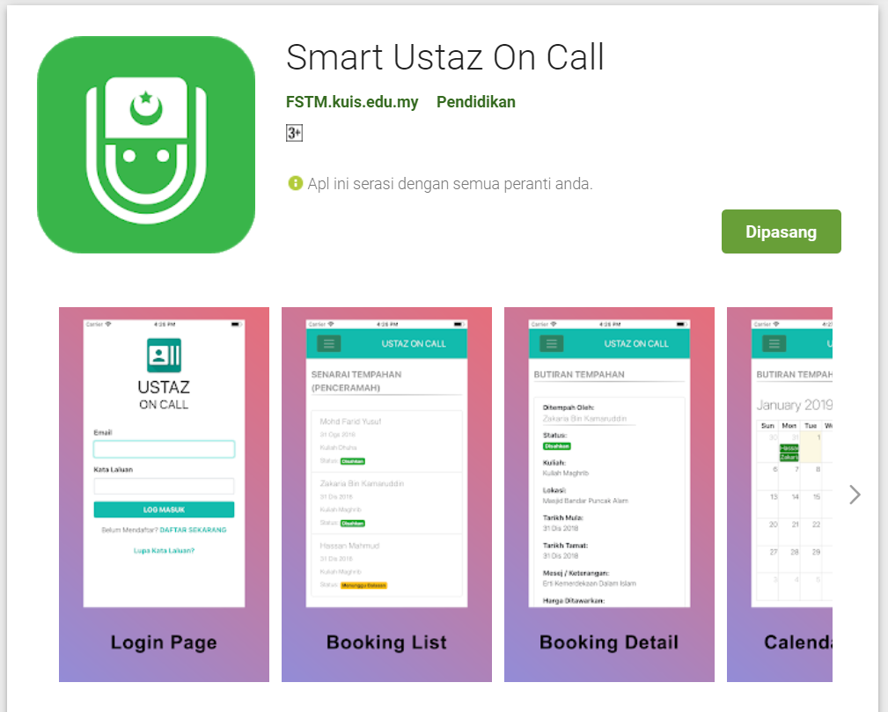
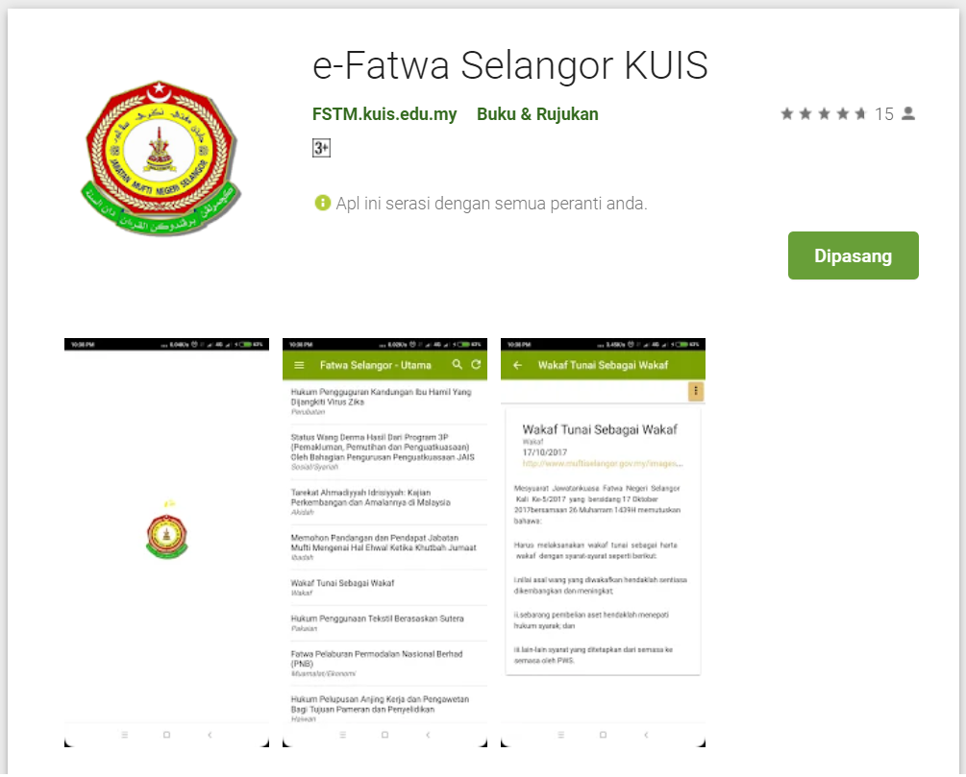
Available apps
bit.ly/m-mathurat

Slide 7
IOS & Android Software Development
In a nutshell

Slide 8





Android Studio
(Java & Kotlin)
Android Device
NATIVE - 2 X WORK
XCode (Swift & Objective C)
iPhone/iPad

Slide 9

1 x WORK
Compile with Android SDK
Android Device
Cordova
Framework
Hybrid
XCode Project
iPhone/iPad

Slide 10
Cordova
Framework
Hybrid
WEB LAYER
NATIVE APP

Slide 11
1 x WORK
Build Progressive Web Apps
Android Device
Build Progressive Web Apps
Cordova
Framework
Hybrid
iPhone/iPad

Slide 12


1 x WORK
Android Studio
Android Device
+
XCode
iPhone/iPad

Slide 13
https://capacitor.ionicframework.com/

Slide 14



WHY IONIC?
Framework specifically to develop apps
Multiple platforms-Android, IOS, Windows, Amazon etc
Apps development using HTML & Typescript (subset of Javascript)
Plugins (camera, thumbprint, bluetooth, printer etc etc etc)

Slide 15
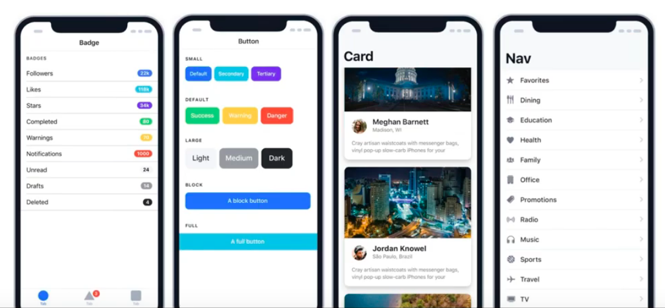
WHY IONIC?
Large COMMUNITY for support
Pre built gestures & animation
100+ UI Components
Everything is OPEN SOURCE
Built with Ionic

Slide 16
Software to start Ionic?

Slide 17
What do you need?
To run IONIC:
Node Package Manager (NPM)
Ionic Cordova Framework
Google Chrome Web Browser
To develop/publish app
VSCode OR any other IDE (with Typescript Plugin)
Ionic Capacitor
Android SDK or Xcode - can be done later

Slide 18
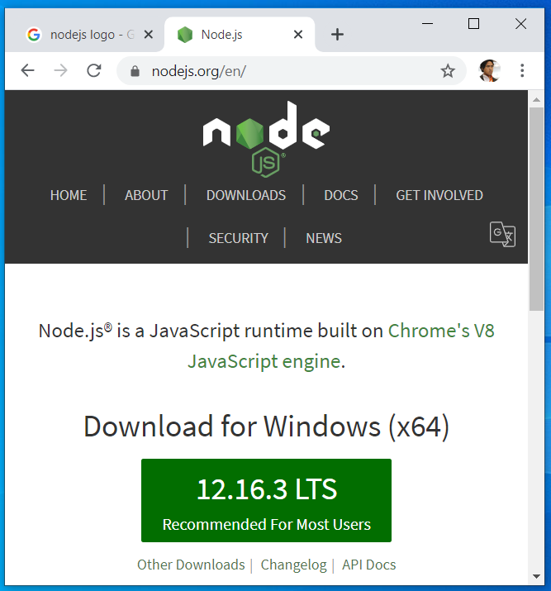

Download from nodejs.org
Download and install the LTS version
http://nodejs.org

Slide 19
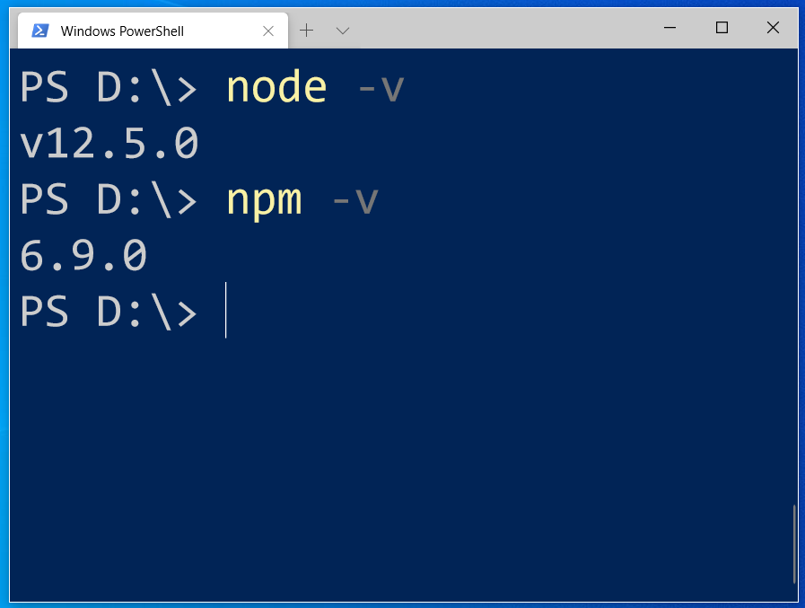
After install NodeJS from nodejs.org
node -v
npm -v

Slide 20
2. From command terminal run:
npm install -g ionic cordova

Slide 21
Now, let’s install the tools

Slide 22
Install VSCode/sublime
NodeJS
Tutorial is here bit.ly/ionickerul
Install Google Chrome Browser
(If you don’t have, you should)

Slide 23
Before we start coding, some basic stuff...

Slide 24
-HTML?
-CSS ?
-TypeScript ?

Slide 25
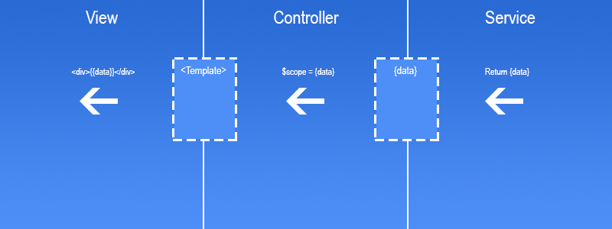
Simple MVC in Ionic
.HTML | .TS | services .TS /Model

Slide 26
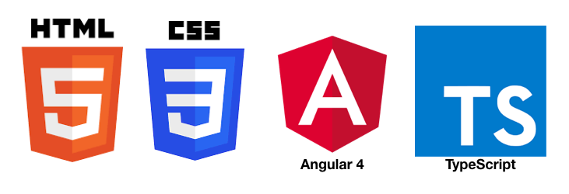
HTML
-Hyper Text Mark Up Language (HTML)
-Used to display the interface
-Write in tags,
-Example- <strong>Hello</strong> → Hello
-Ionic has its own built in tags
<ion-list></ion-list>
<ion-item></ion-item>
<ion-grid></ion-grid>
-HTML in Ionic is “AngularJS Flavoured”
-Have to use Angular Syntax for data and clicks
-Example- (click), *ngFor etc

Slide 27
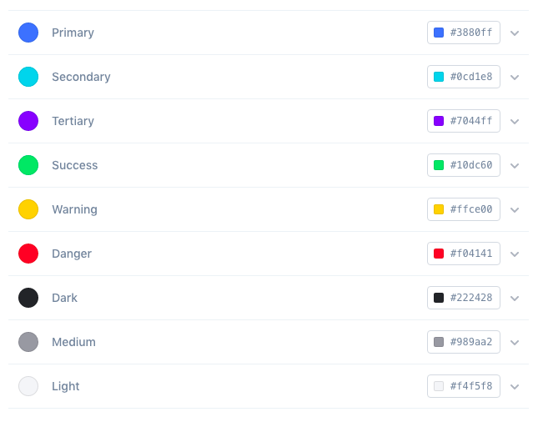
CSS or SCSS
-Cascading Style Sheets (CSS)
-Used for styling, very straightforward
-Each generated Ionic page comes with built in own CSS
-Can assist in ‘theming’ the app
-Ionic has standard built in colours
-Primary, Secondary, Danger, Light & Dark
Built in colours that can be added/edited

Slide 28
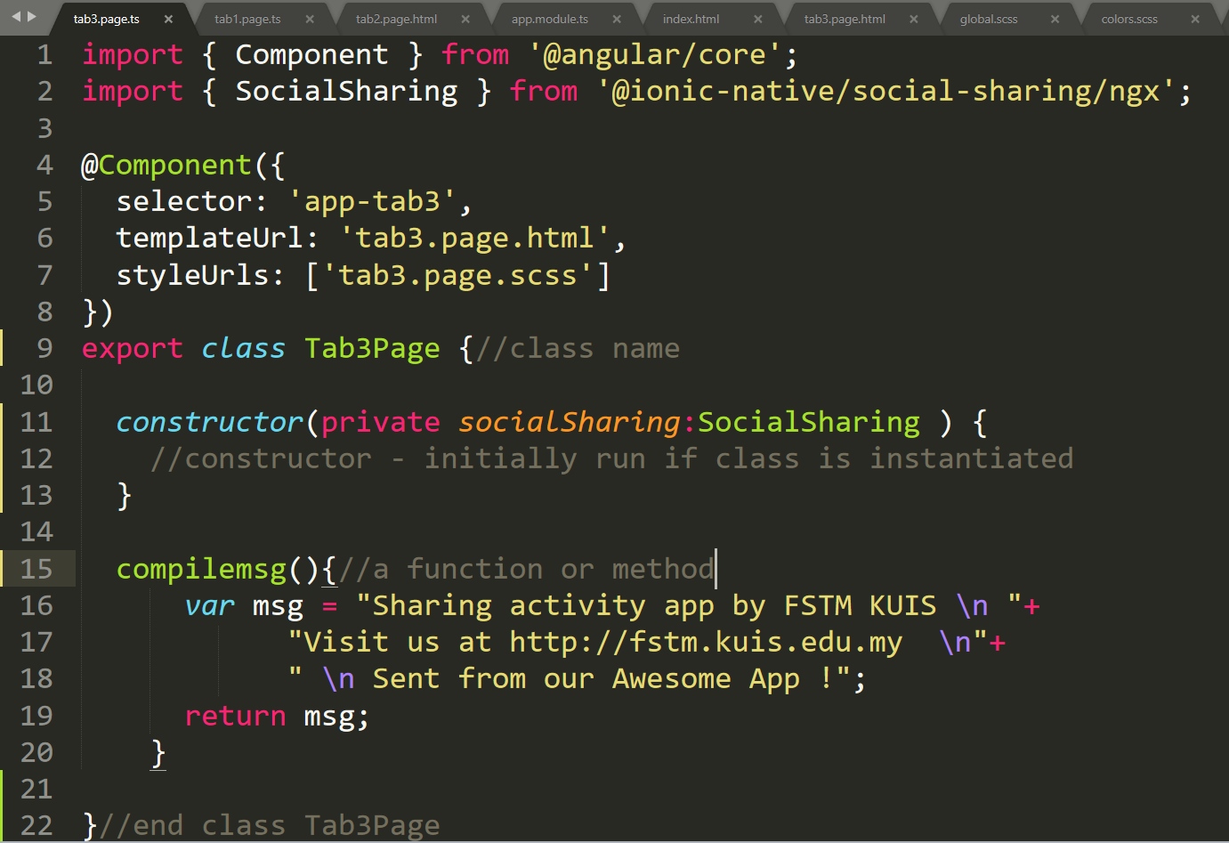
Class Function

Slide 29
Hello World ionic

Slide 30
1. Start a project
ionic start appfstm tabs

Slide 31
2. CD into Directory & Run the project
ionic serve

Slide 32
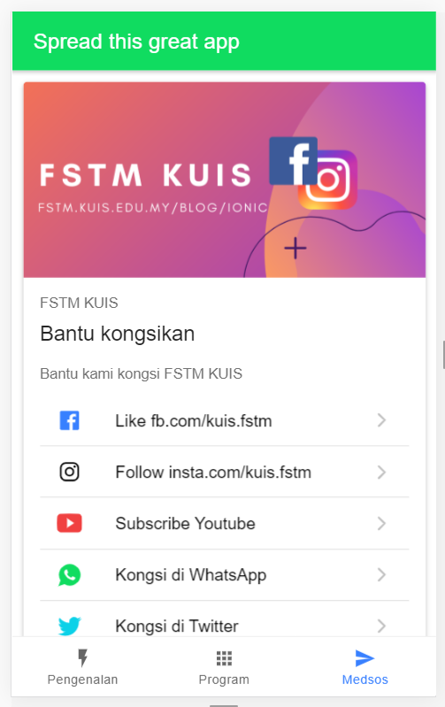

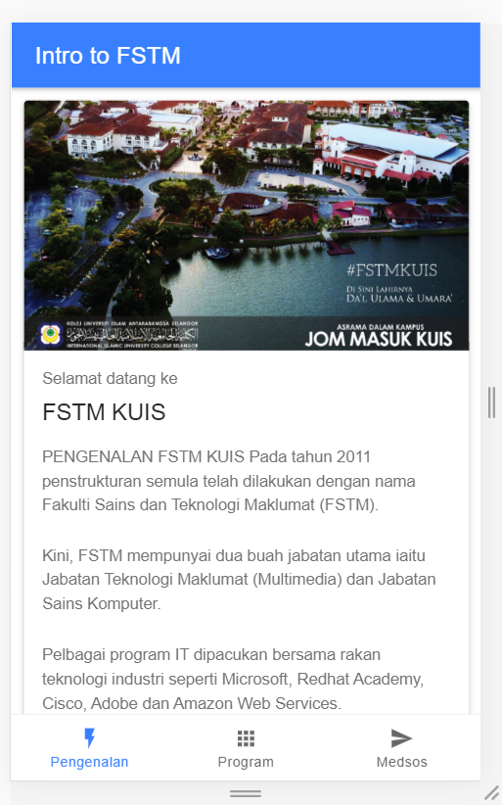
Next tab2 and tab3

Slide 33


bit.ly/ionkerul
T02 HTML interface
(antaramuka)

Slide 34
1. Start a project
ionic start appfstm tabs

Slide 35
2. CD into Directory & Run the project
ionic serve

Slide 36
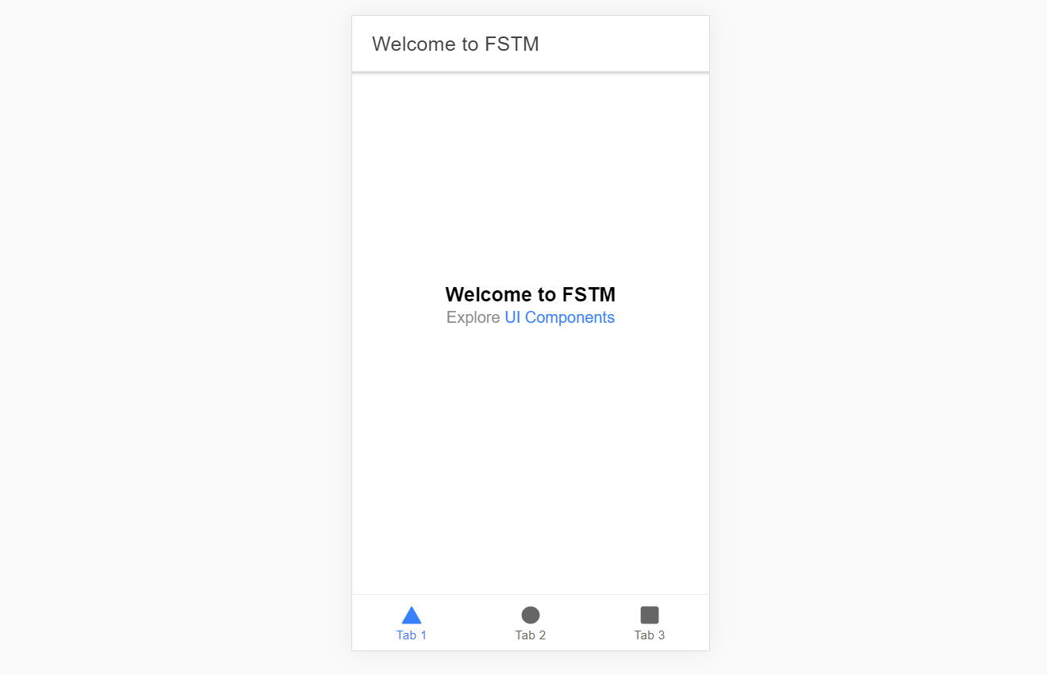
Output : ionic serve

Slide 37
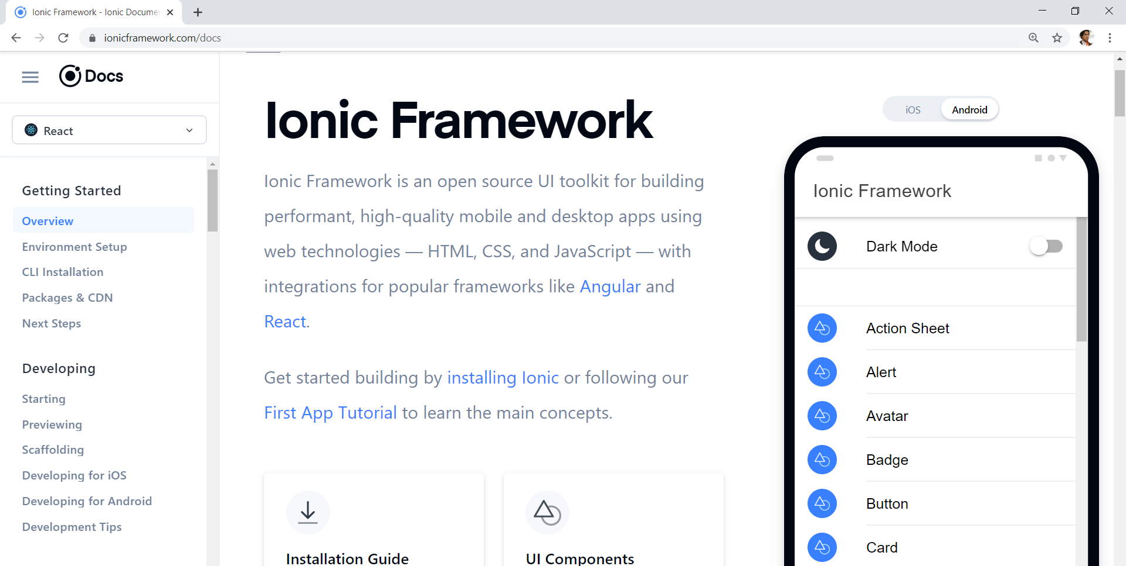
Always refer to documentations: https://ionicframework.com/docs

Slide 38
HTML
-Hyper Text Mark Up Language (HTML)
-Used to display the interface
-Write in tags,
-Example- <strong>Hello</strong> → Hello
-Ionic has its own built in tags
<ion-list></ion-list>
<ion-item></ion-item>
<ion-grid></ion-grid>
-HTML in Ionic is “AngularJS Flavoured”
-Have to use Angular Syntax for data and clicks
-Example- (click), *ngFor etc

Slide 39
CSS or SCSS
-Cascading Style Sheets (CSS)
-Used for styling, very straightforward
-Each generated Ionic page comes with built in own CSS
-Can assist in ‘theming’ the app
-Ionic has standard built in colours
-Primary, Secondary, Danger, Light & Dark
Built in colours that can be added/edited

Slide 40
Next tab2 and tab3

Slide 41
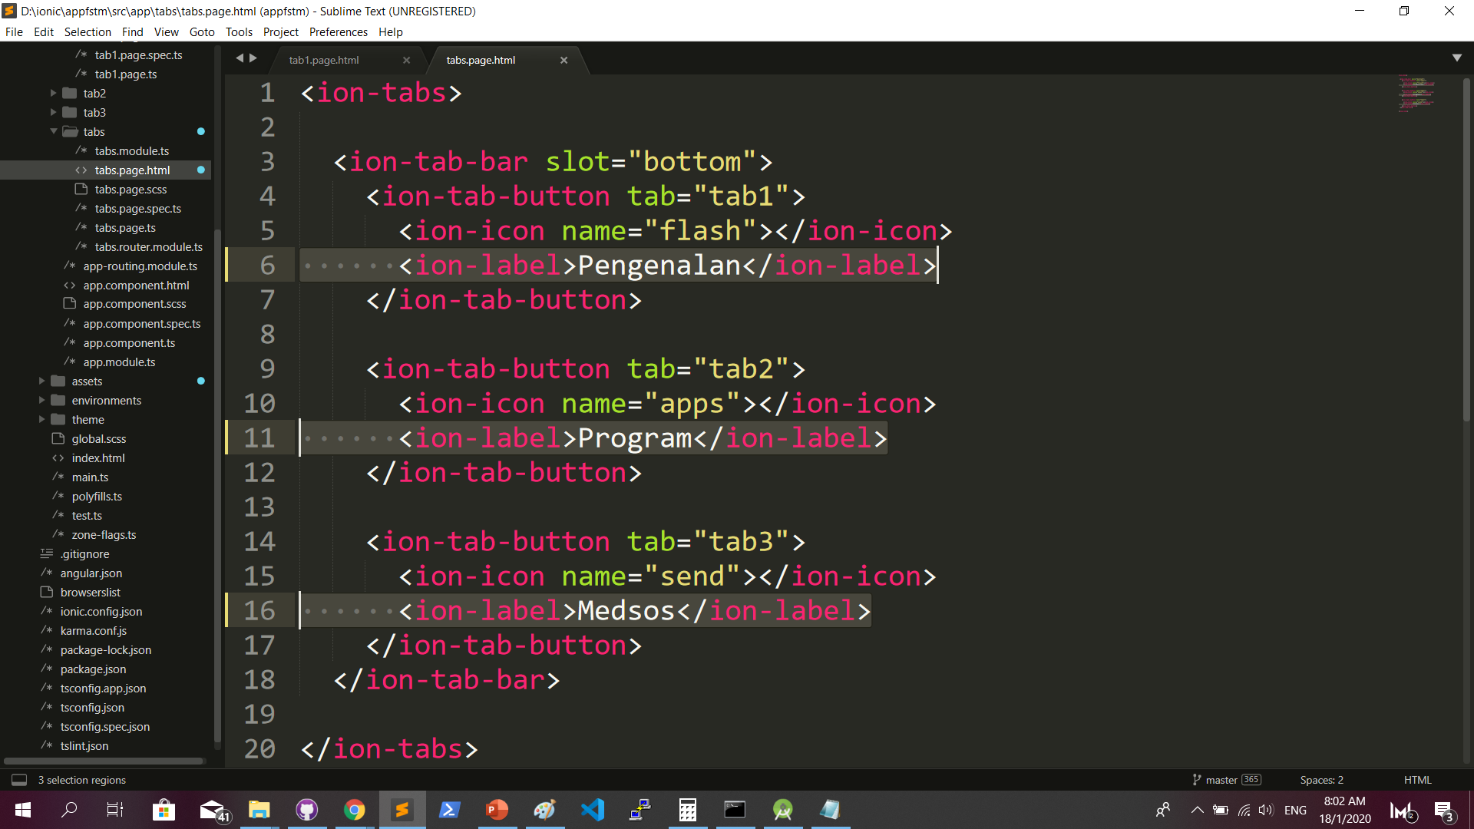
Some interface cosmetics: src/app/tabs/tabs.page.html

Slide 42
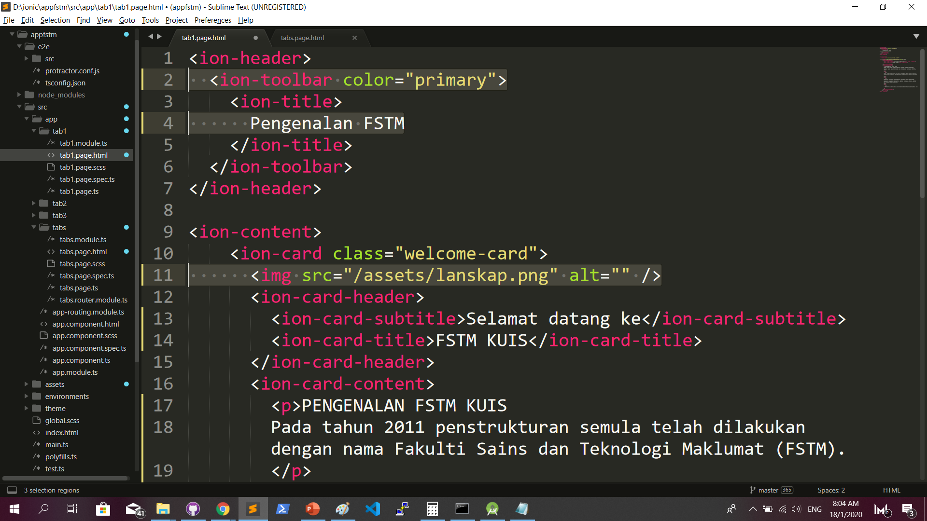
More interface cosmetics: src/app/tab1/tab1.page.html

Slide 43
Run ionic serve

Slide 44
Next tab2 and tab3

Slide 45
Codes & slides github.com/khirulnizam/ionic5

Slide 46
bit.ly/ionkerul
T03 Navigasi
(page navigation)

Slide 47
Page Navigation
+ routerLink (in .html) + NavController (in .ts)

Slide 48
routerLink in HTML
PAGE 1
PAGE 2
See app-routing.module.ts for page name

Slide 49
Exercise : Link to new page
Generate new pages
ionic g page info
ionic g page form

Slide 50
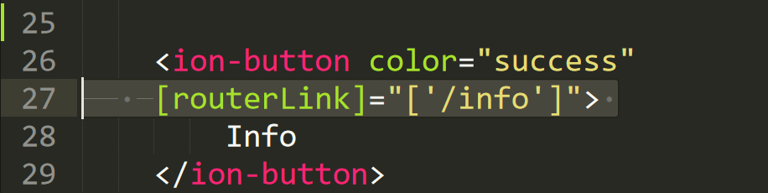
Exercise : Link to new page

Slide 51
NavController in TS
PAGE 1
PAGE 2
See app-routing.module.ts for page name

Slide 52
Add simple form interaction
+ Form Button + Alert function

Slide 53
Try building a button and make an alert
helloWorld(){
alert("Hello Ionic! ")
}
<ion-button (click)="helloWorld()"> ALERT </ion-button>
info.page.ts
info.page.html

Slide 54

Codes & slides github.com/khirulnizam/ionic5

Slide 55


T04 TypeScript

Slide 56
TypeScript
-A subset of Javascript
-Part of ECMA6 standard
-The ‘brains’ behind your app
-Used for processing & handling data
Example- calculation, accessing DB etc
-Ionic has standard built in to its TS:
NavController, ModalController etc

Slide 57
Typescript Syntax : Function
let n1:number;
let n2:number;
output:number;
addnumbers(){
output=n1+n2;
displayresult( );
}
displayresult( ){
alert(“Output: ”+output);
}

Slide 58
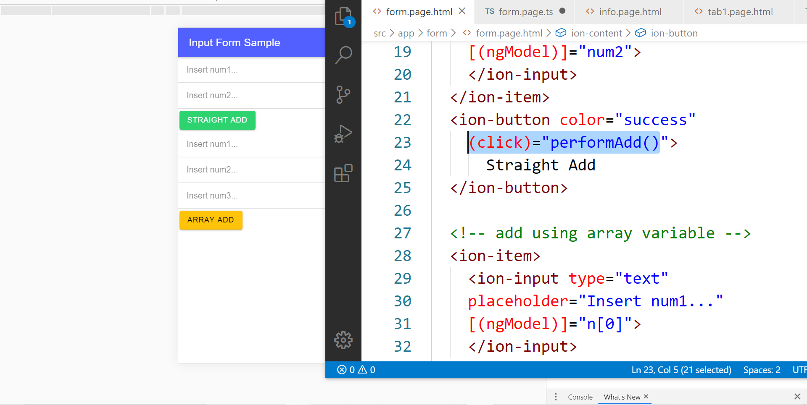
In file .HTML

Slide 59
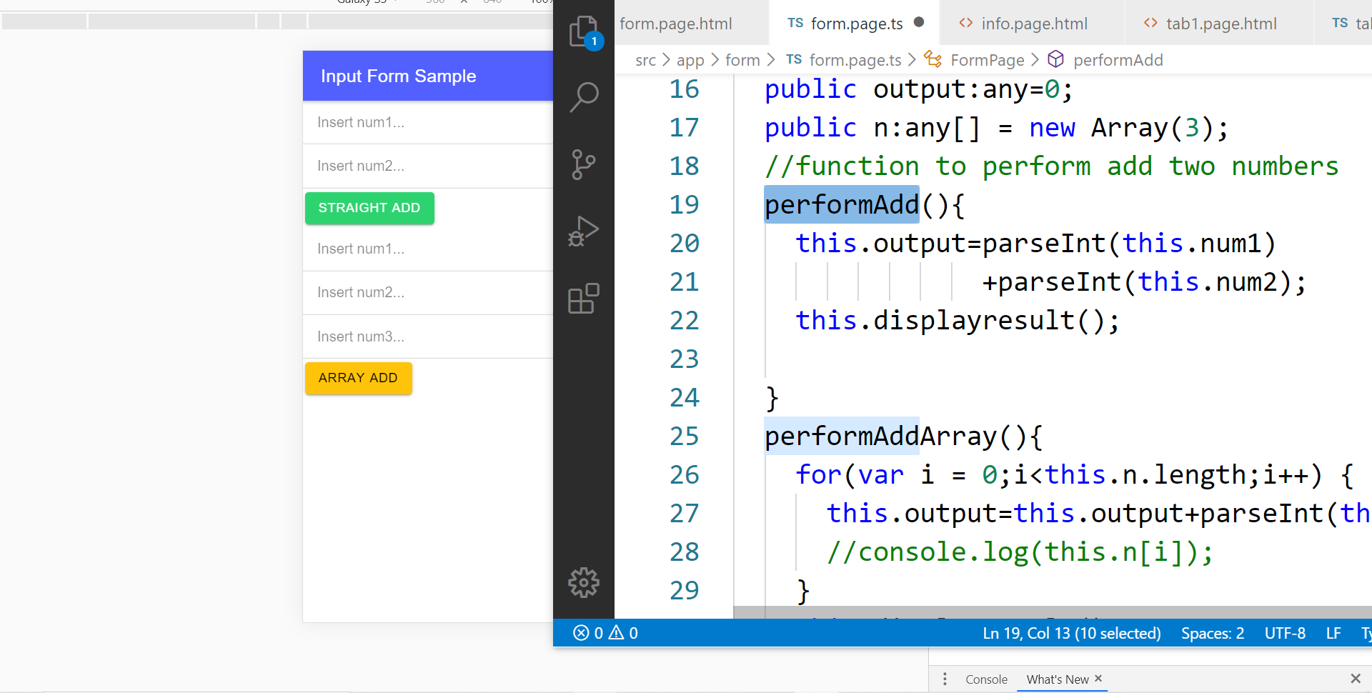
In file .TS

Slide 60
TypeScript Syntax : EX1 variable
What is a variable?
A variable acts as a container for values in a programming code.
var pi:number = 3.14;
Var num1:number=5;
var name:string =“enKerul”;
Use any to loosely-type the variable data type.
Data types:
any
can be numbers or strings
string
“this is string ” + “ concat ”
number
Double 3.14, or integer 5
array
can be a collection of Var, Strings or Objects

Slide 61
Typescript Syntax : EX2 String manipulation & Casting
//to convert String to number
var str = "54";
//easy way by using + operator
var num = +str; var num = parseInt(str);
String manipulation?
var str:string = "3.14";
var pi:number = 3.14;
console.log("pi is "+pi);
console.log("tau is "+(2 * pi));

Slide 62
Typescript Syntax : EX3 Array
Array? Array
can be a collection of Var, Strings or Objects
// A list literal.
var numbers = [4, 1, 5, 6, 3, 2];
for(var i=0;i<numbers.length; i++)
{
sum=sum+numbers[i]);
console.log(“Sum: ”+sum);
}
-----
Output
Sum: 21

Slide 63
Typescript Syntax : EX4 Associative array
Associative Array?
Array with key and value pairs (not index number).
// A map literal.
// Asociative array
var gases = [
'He': 'Helium',
'Ne': 'Neon',
'Ar': 'Argon’,
];
console.log(gases['Ne’]);
-------------------------
Output: Neon

Slide 64


T05 Kamera (installing camera plug-ins)

Slide 65
Codes & slides github.com/khirulnizam/ionic5

Slide 66
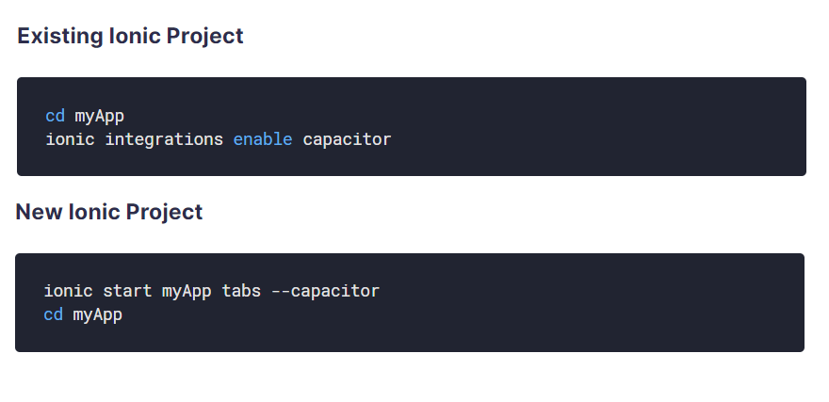
Using Capacitor with Ionic

Slide 67
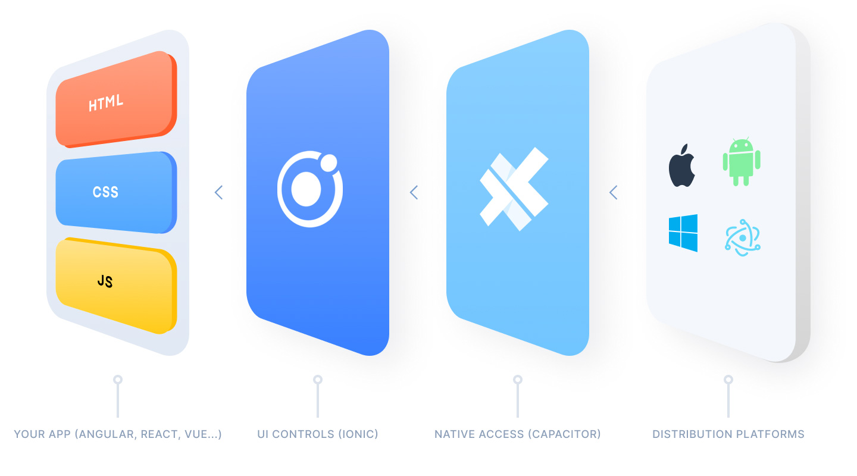
Ionic Capacitor
https://ionicframework.com/resources/articles/capacitor-vs-cordova-modern-hybrid-app-development
runs modern Web Apps natively on iOS, Android, Electron, and Web

Slide 68
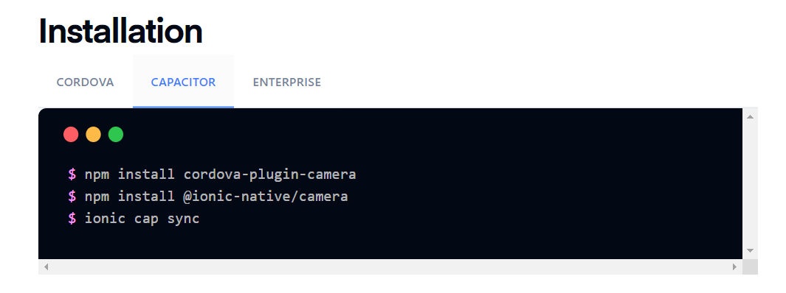
Install camera support : ionicframework.com/docs/native/camera

Slide 69
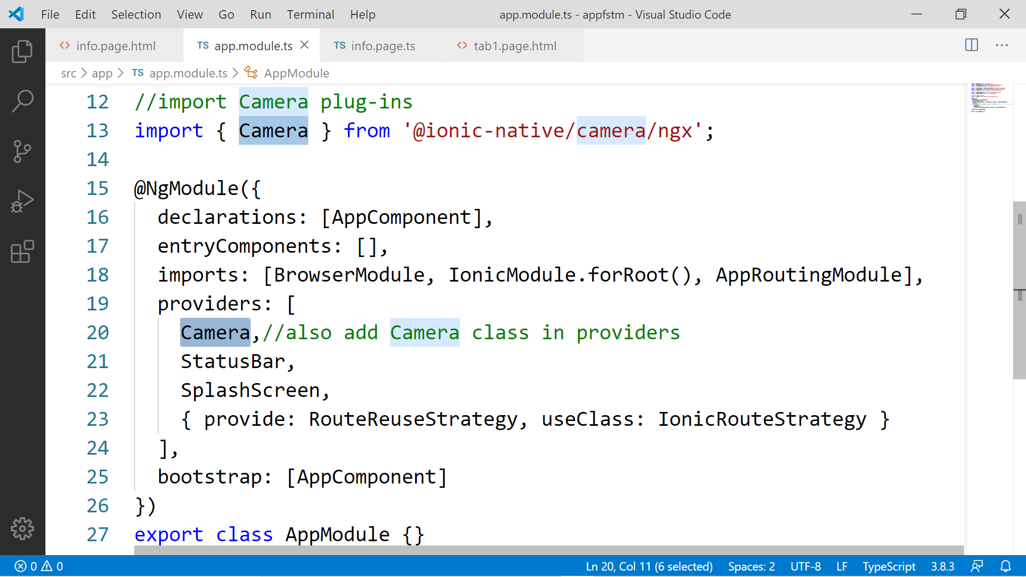

Slide 70
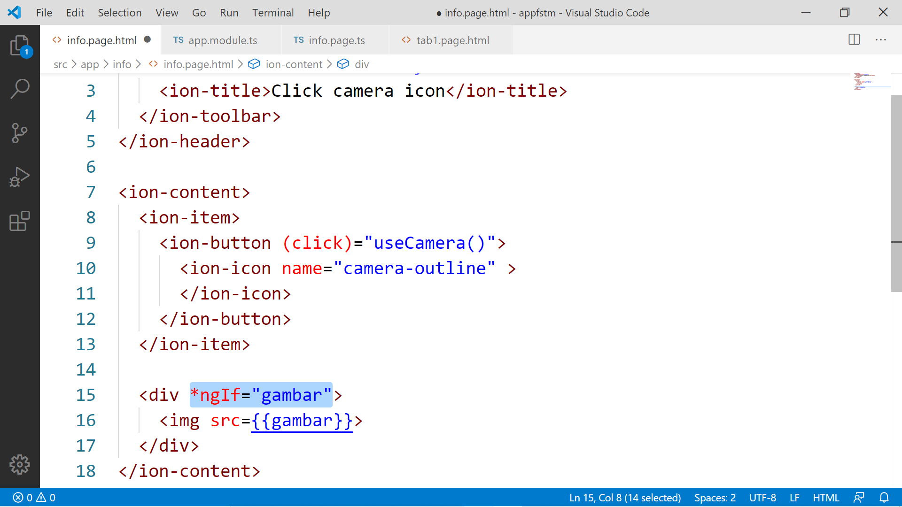

Slide 71
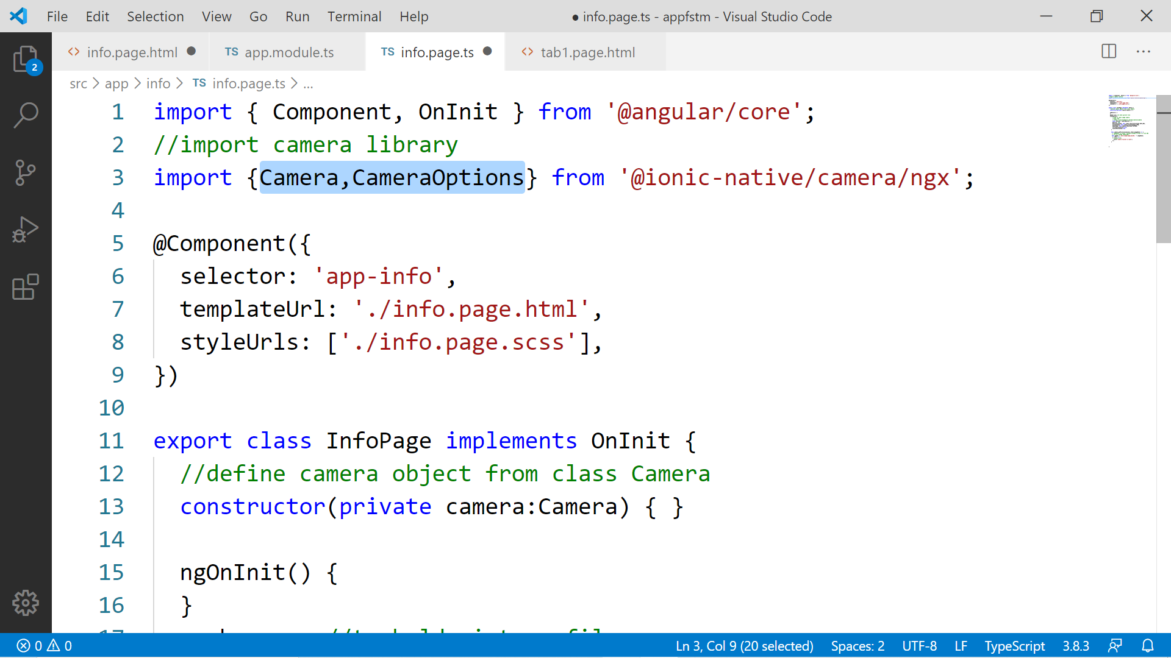

Slide 72
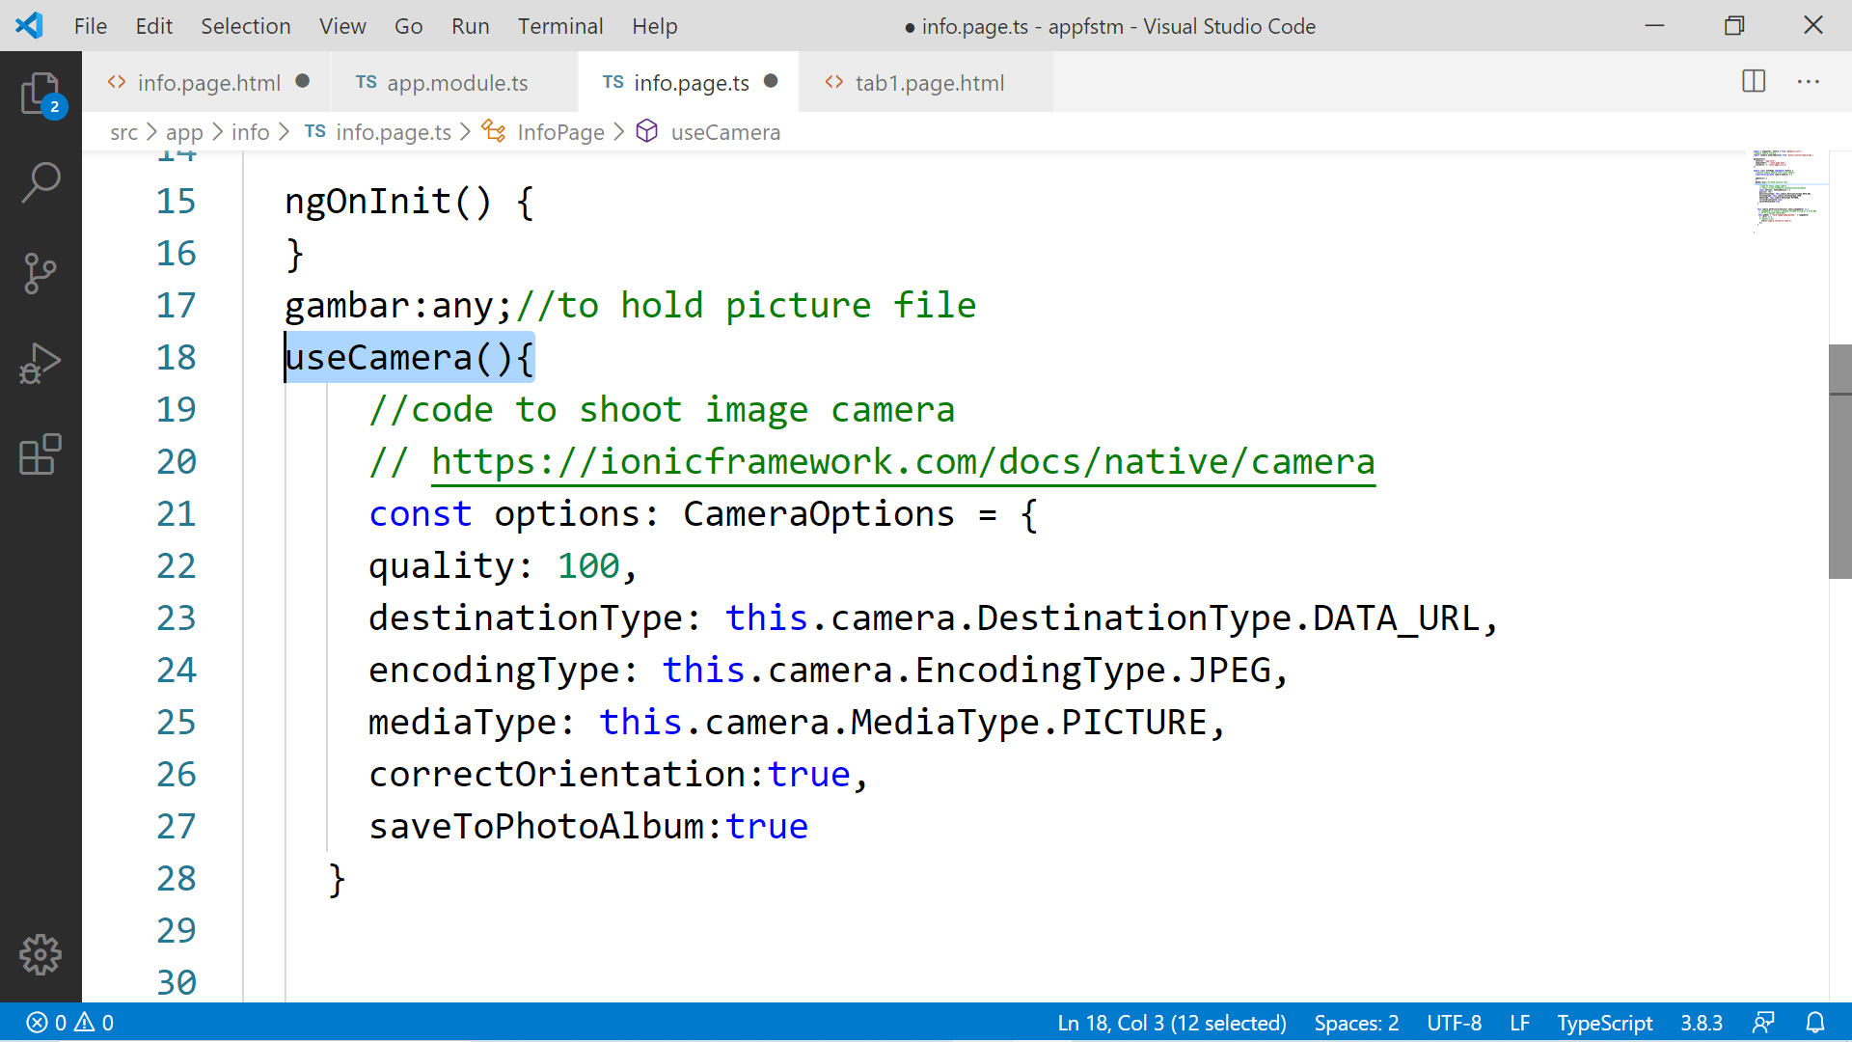

Slide 73
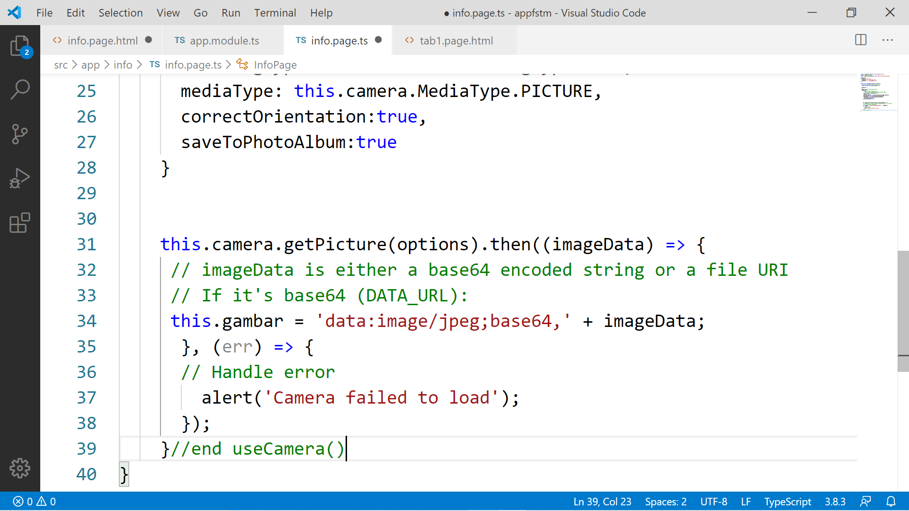

Slide 74
Migration Cordova to Capacitor - error: package android.support.v4.content does not exist
npm install jetifier
npx jetifier
npx cap sync android

Slide 75
Ionic Capacitor
https://ionicframework.com/resources/articles/capacitor-vs-cordova-modern-hybrid-app-development
runs modern Web Apps natively on iOS, Android, Electron, and Web

Slide 76
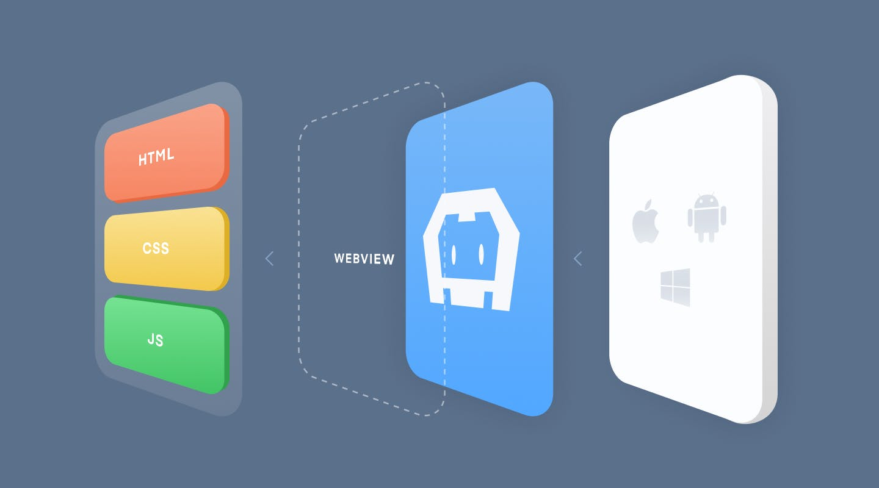
Previously we have CORDOVA

Slide 77
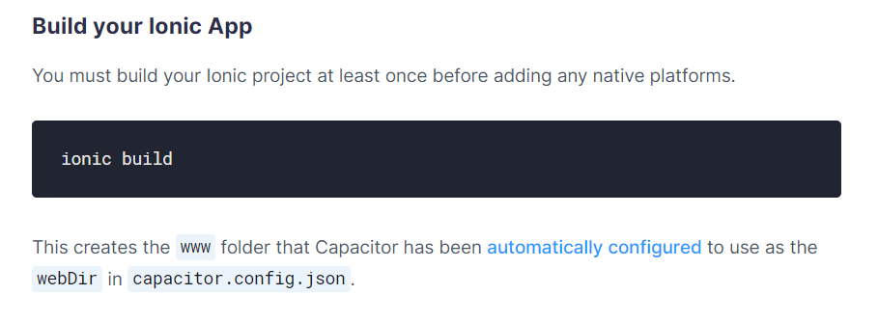
Ionic build

Slide 78
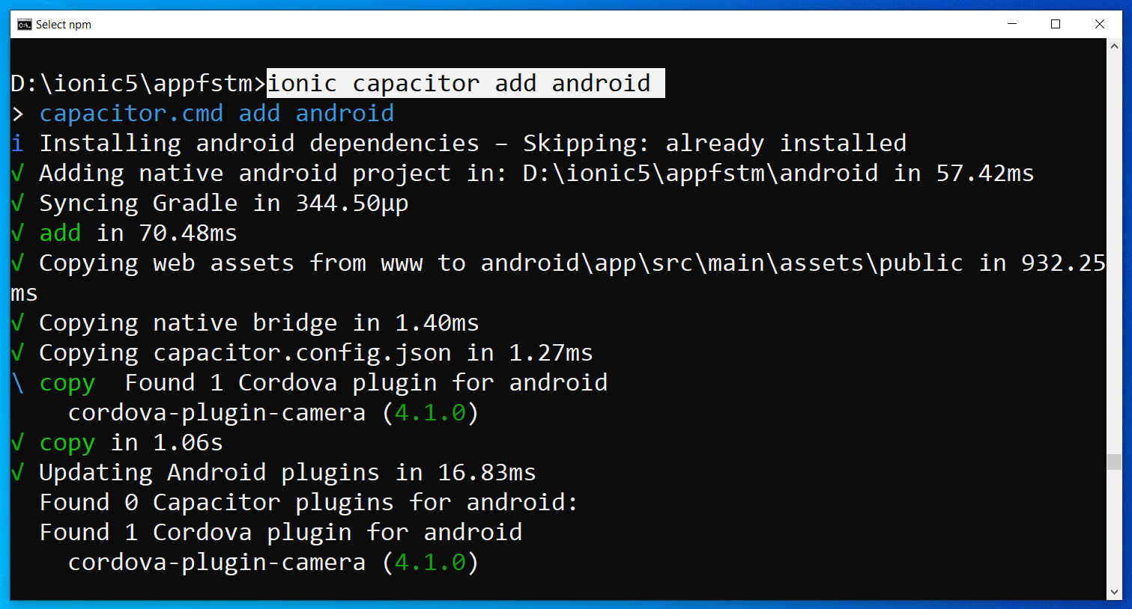
Run only once for each ionic project
To update Android project, execute
ionic build
npx cap copy

Slide 79
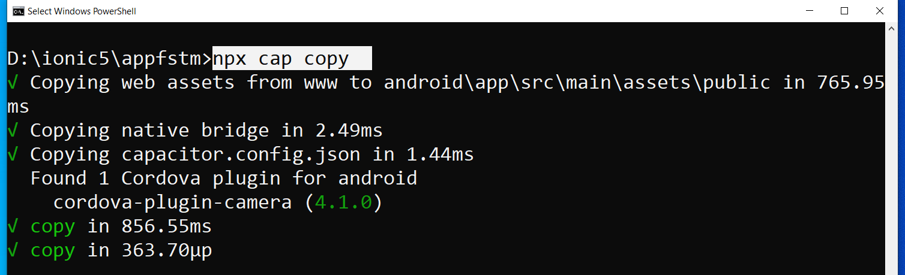
After finish installing the camera plug-ins

Slide 80
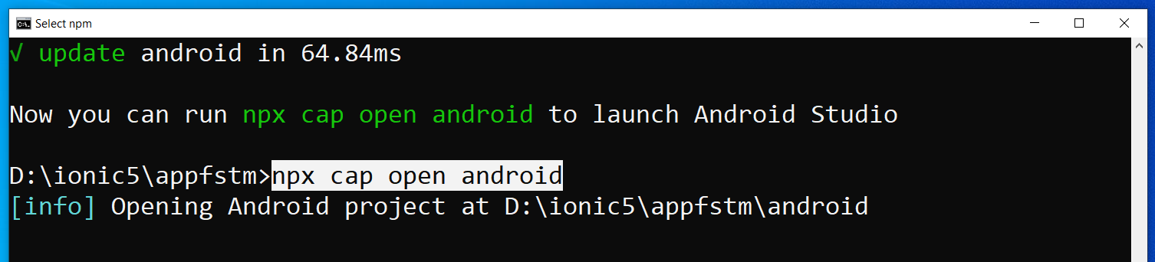
To open project on Android Studio

Slide 81
Codes & slides github.com/khirulnizam/ionic5

Slide 82
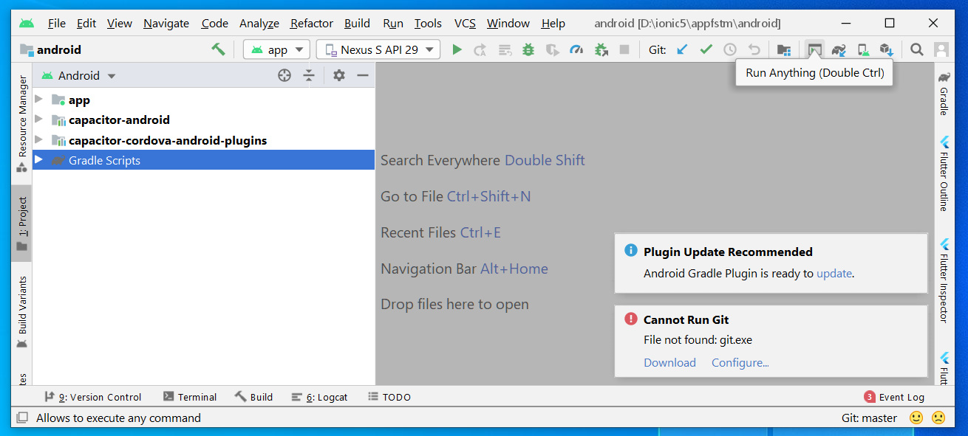
Open in Android Studio

Slide 83

T06 Uji-lari (run app on Android)

Slide 84

Android Studio 3.6 & SDK developer.android.com/studio

Slide 85
Path settings (environment variables)
ANDROID_SDK_ROOT
JAVA_HOME

Slide 86
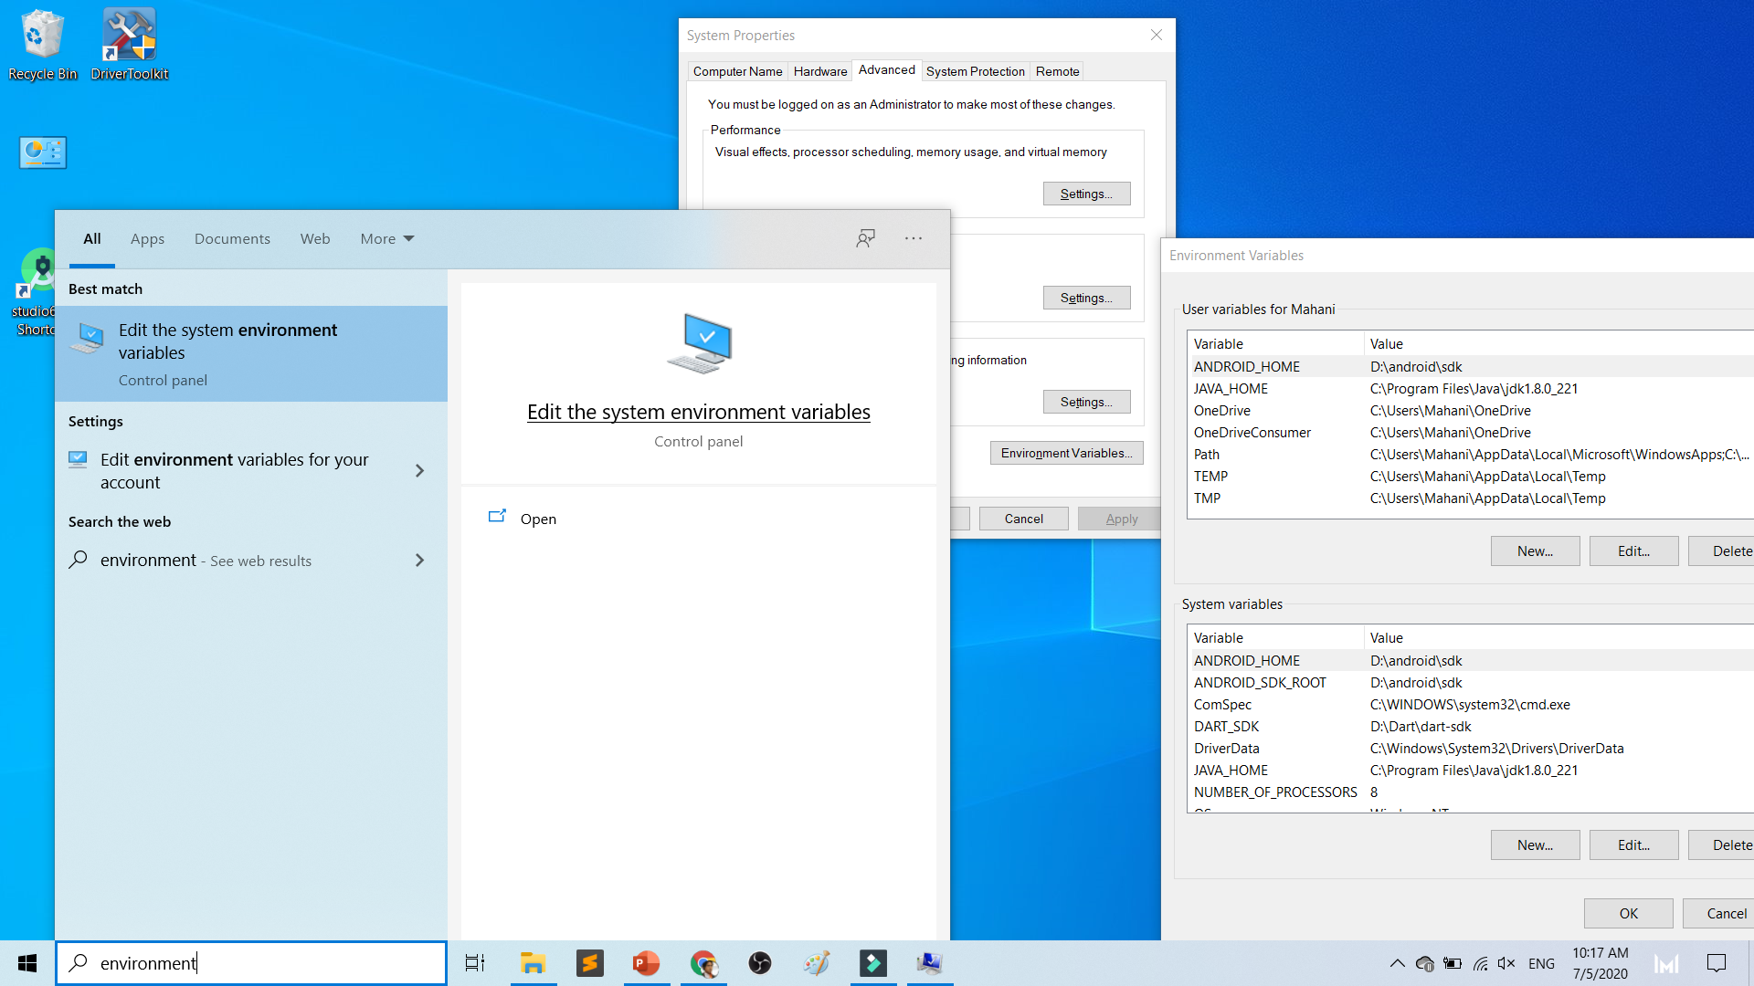

Slide 87
To deploy
Android Studio
Android SDK
Android Phone with USB Debugging enabled
ADB Bridge
USB Data-cable for Actual Device

Slide 88
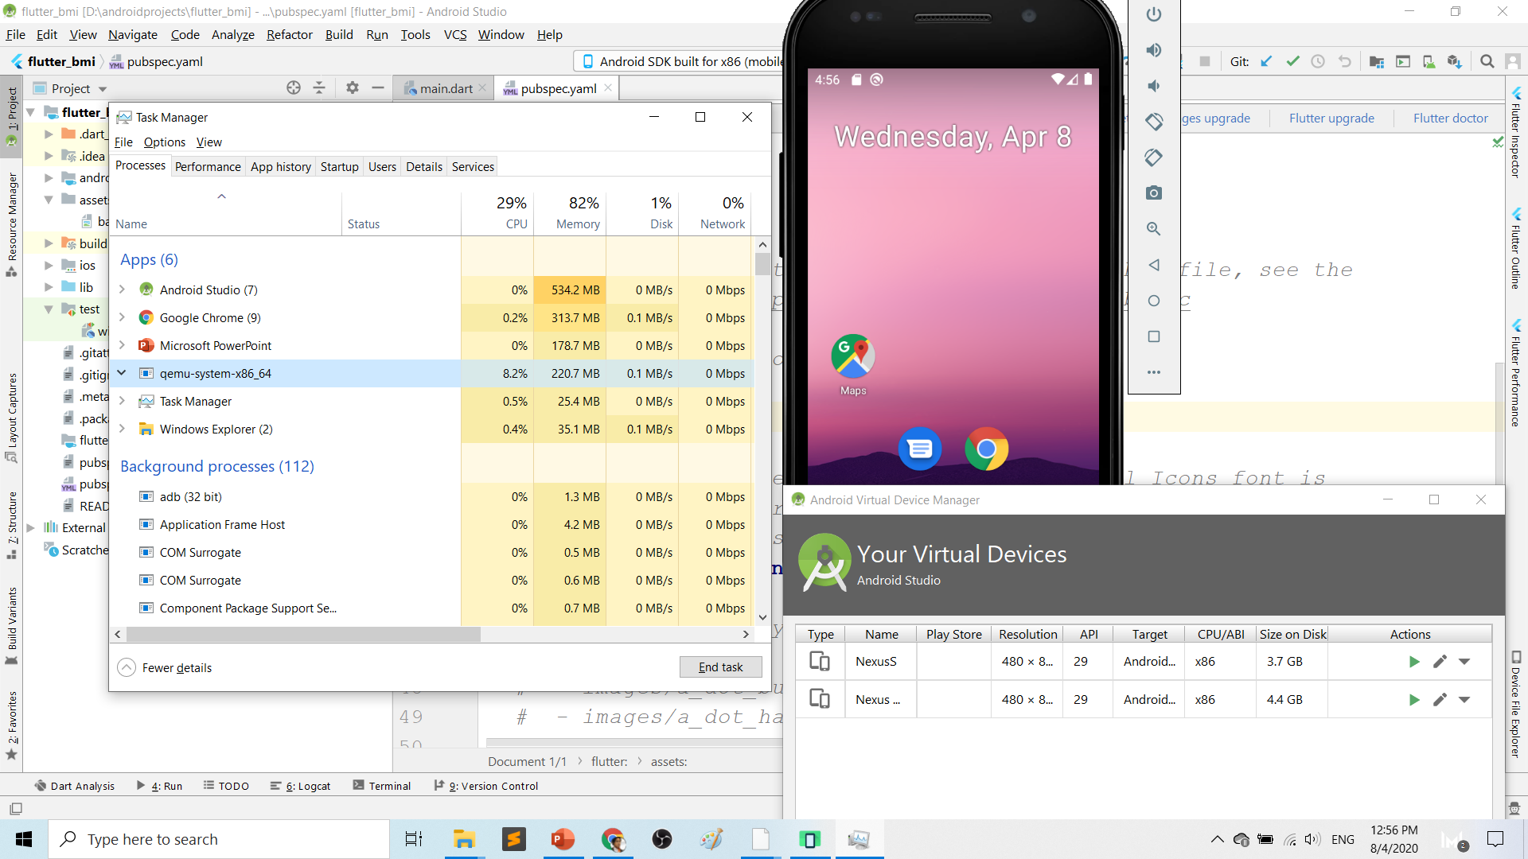
Play.google.com
What’s wrong with Android Studio & Emulator? RESOURCE-HUNGER

Slide 89
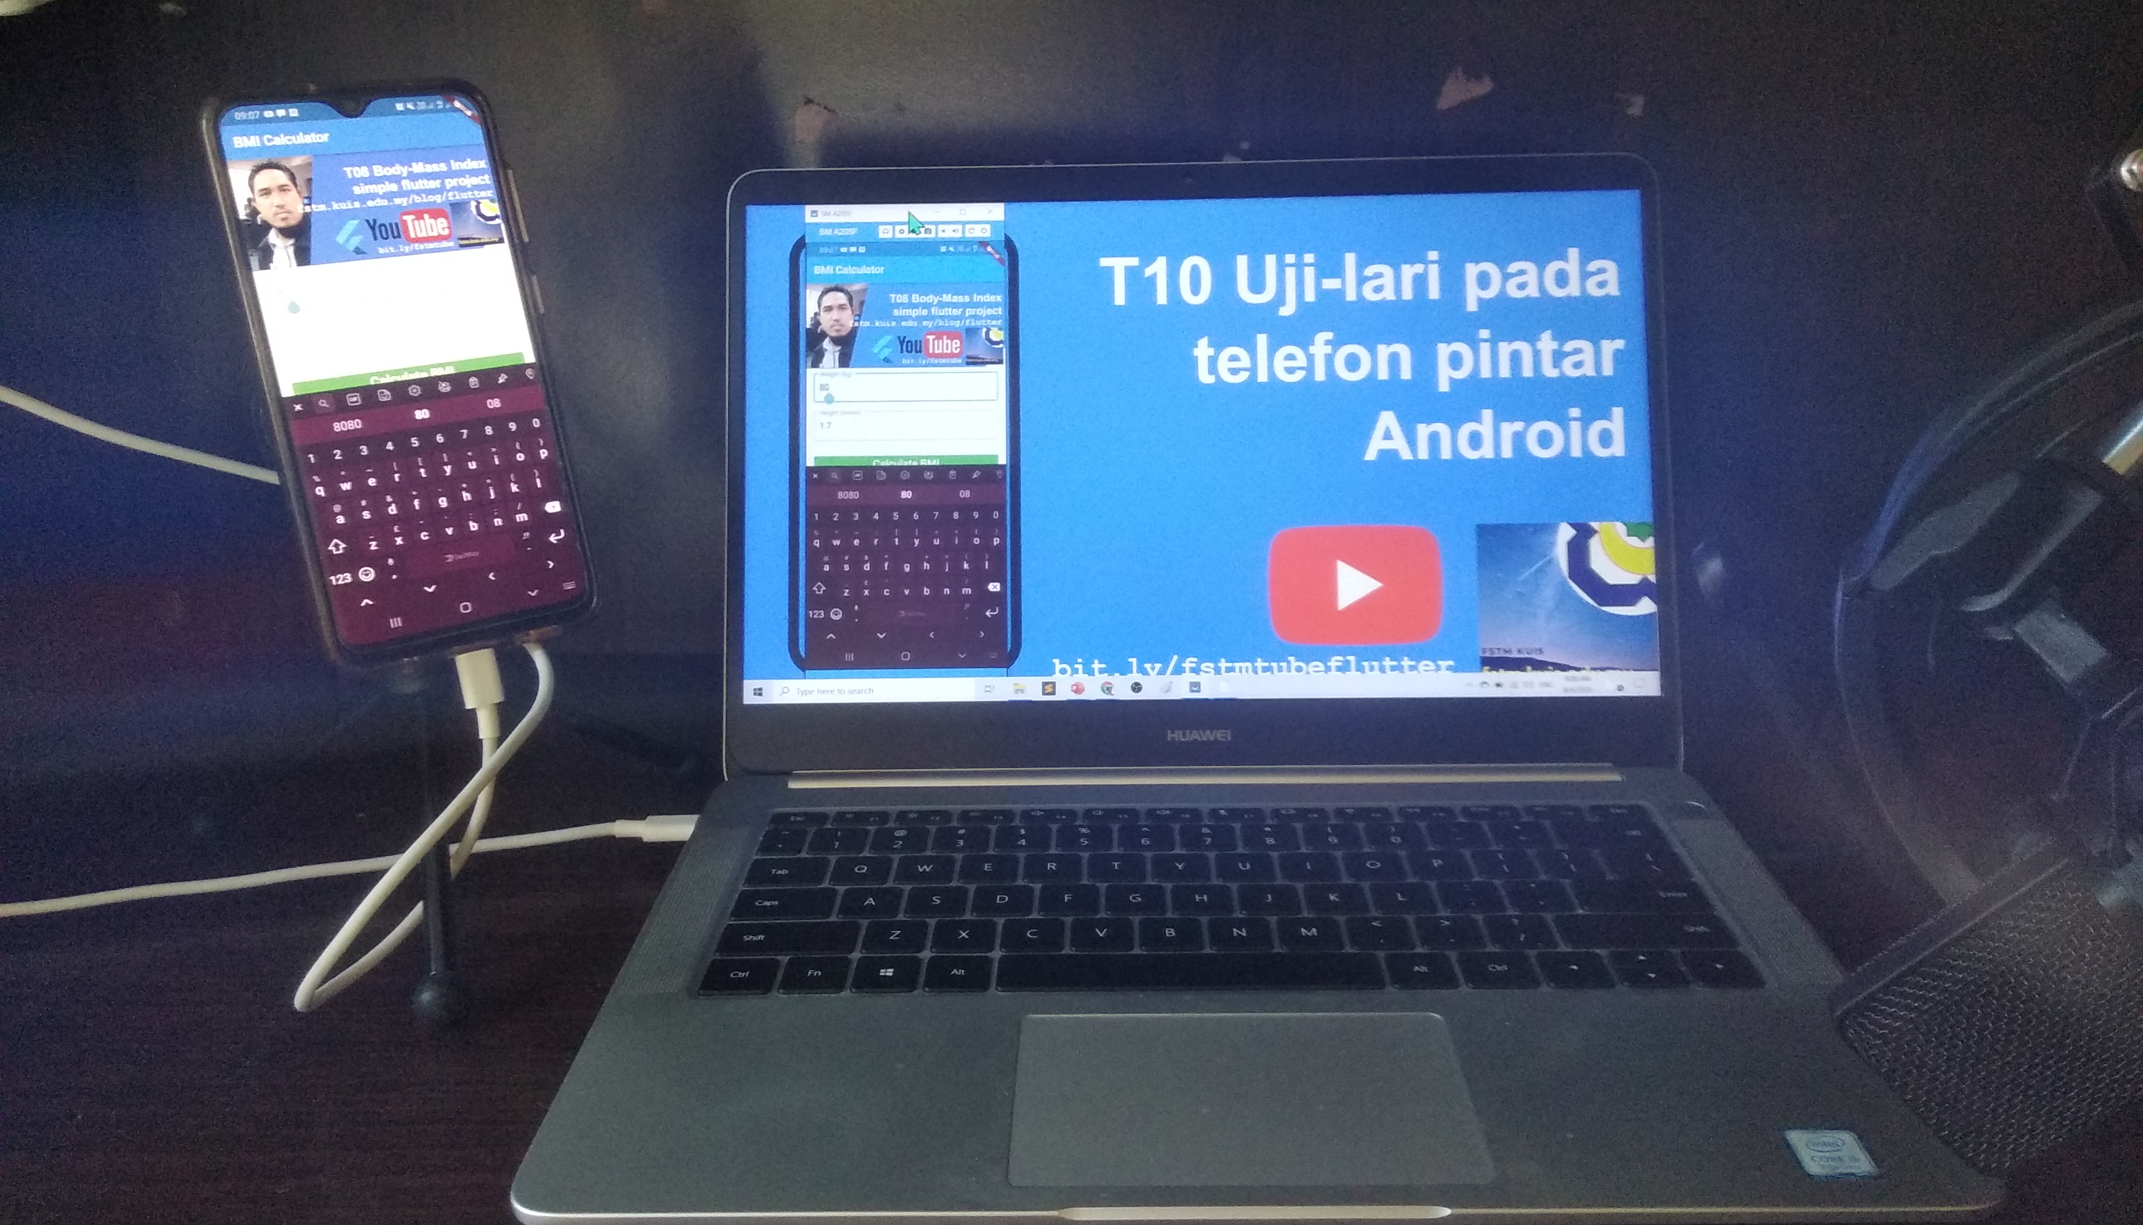
Requirements 1. USB debugging ON- phone 2. Connect USB Cable 3. Install ADB driver in PC

Slide 90
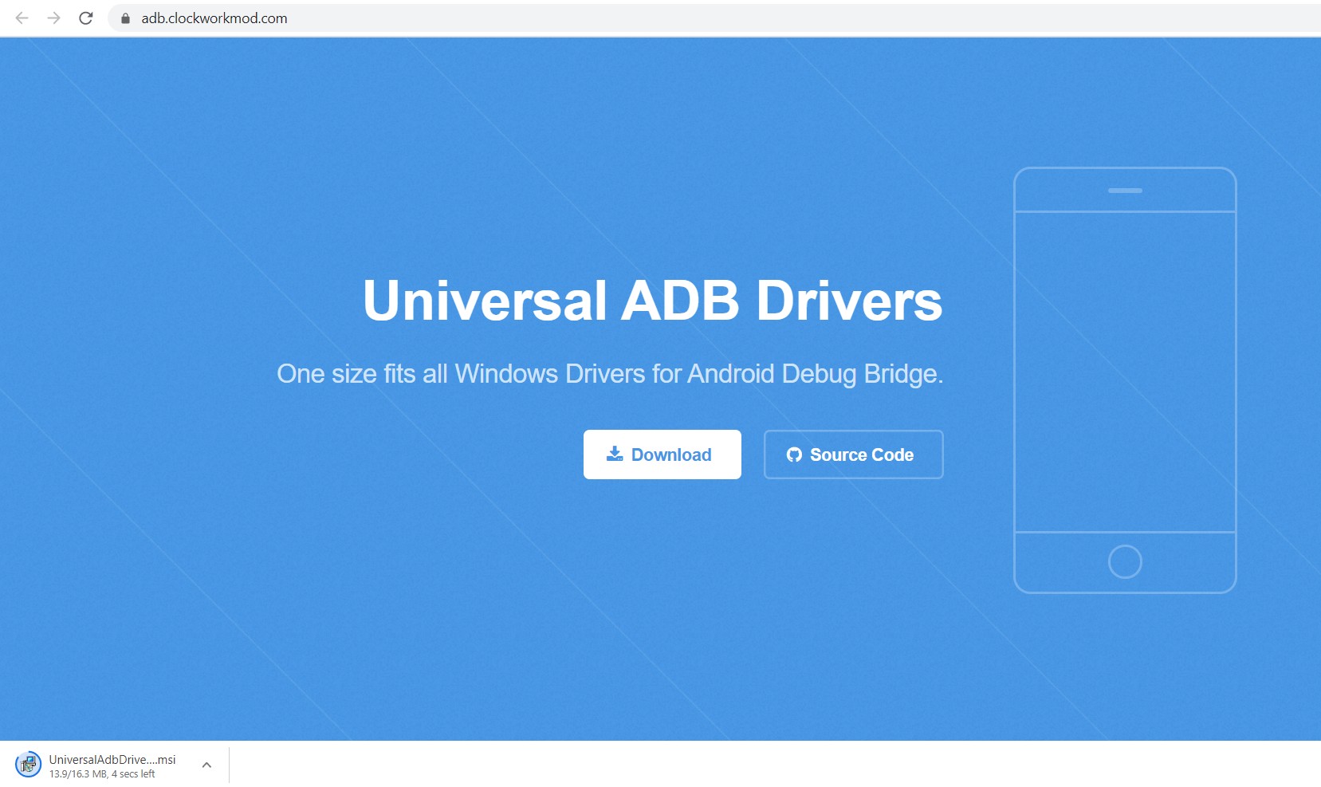
Play.google.com
Install universal debug driver
https://adb.clockworkmod.com/
Download & install universal debug

Slide 91
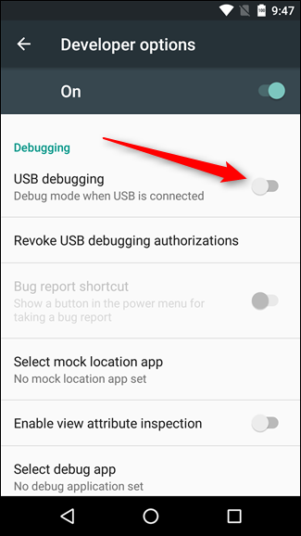
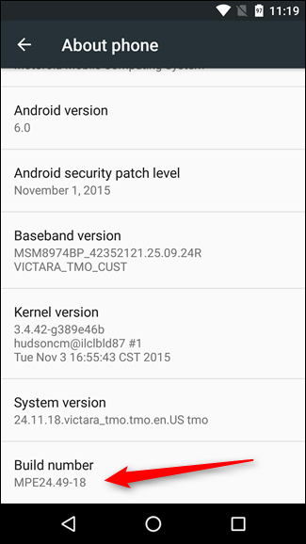
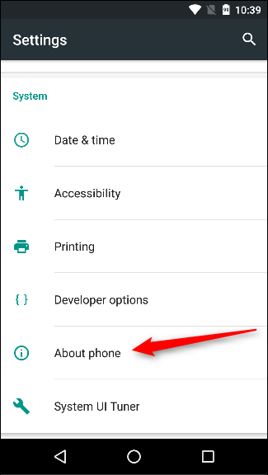
First time to on USB Debugging?
Developer options enable
Press 7X on build number
press 7x

Slide 92
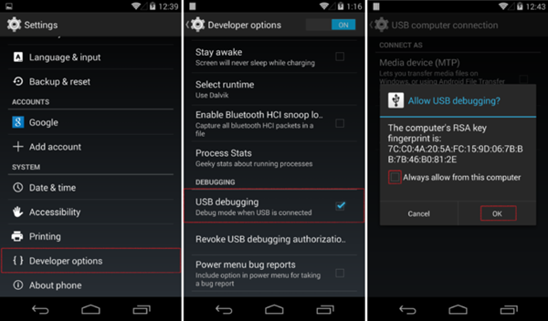
First time Allow USB debugging?

Slide 93





T06 Feed from Android
to OBS using Vysor
by enKerul, jsk fstm kuis
bit.ly/fstmobs

Slide 94
Ionic build

Slide 95
Create Android project/platform ionic capacitor add android
Run only once for each ionic project
To update Android project, execute
ionic build
npx cap copy

Slide 96
Copy to www to android project npx cap copy

Slide 97
To open project on Android Studio npx cap open android

Slide 98
Open in Android Studio

Slide 99
Codes & slides github.com/khirulnizam/ionic5

Slide 100


bit.ly/ionkerul
T07 Pilihan Selection : if…else, ngIf

Slide 101
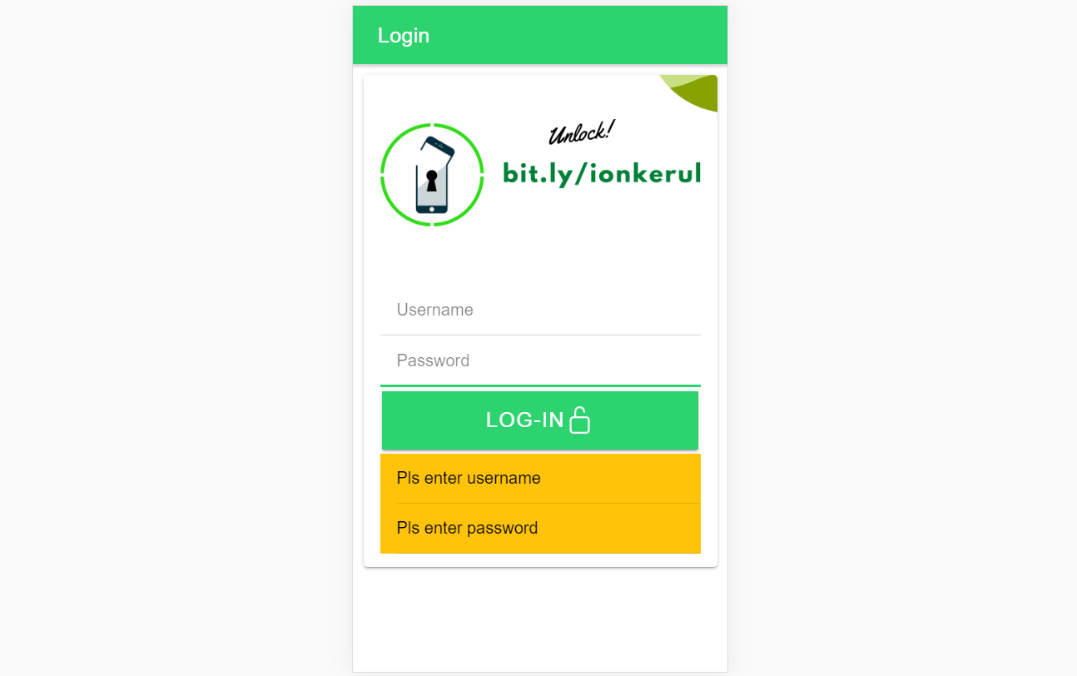
Output overview

Slide 102
Create a new page
ionic g page login
(selection exercise)

Slide 103
[(ngModel)]
Example:
IN TYPESCRIPT:
username:any;
password:any;
IN HTML:
<ion-input [(ngModel)]= “username”>
</ion-input>
<ion-input [(ngModel)]= “password”>
</ion-input>
[(ngModel)] USED IN HTML to capture what is typed into input to TypeScript

Slide 104
*ngIf used in HTML
Usually used for array iterations
Example:
IN HTML
<div *ngIf= “ username==null ”>
Pls enter username
</div>
<div *ngIf= “ password==null ”>
Pls enter password
</div>
*ngIf USED IN HTML

Slide 105
*ngIf … else used in HTML
<div *ngIf="gambar; else noImageYet">
<img src="{{gambar}}">
</div>
<ng-template #noImageYet>
<img src="./assets/noimagep.png">
</ng-template>
*ngIf … else USED IN HTML

Slide 106
IF...ELSE IF...ELSE AND *ngIFStatements
Usually used for selection and/or filtering
Example:
if(username== null){
alert(“Pls insert username”);
}
else if(password==null){
alert(“Pls insert password”);
}
else {
alert(“Welcome user”);
}
IF...ELSE IF..ELSE USED IN TYPESCRIPT IS EXACTLY THE SAME AS JAVASCRIPT

Slide 107
Output

Slide 108

bit.ly/ionkerul
T08 Ulangan Repetition : for, foreach, ngFor

Slide 109
Codes & slides github.com/khirulnizam/ionic5

Slide 110
Create a new page
ionic g page irepeat
(repetition exercise)

Slide 111
For Loop and *ngFor
Usually used for array iterations. Example:
negeri[0]= “Johor”;
negeri[1]= “Melaka”;
negeri[2]= “N. Sembilan”;
negeri[3]= “Selangor”;
for(var x=0;x<negeri.length;x++)
{
console.log(negeri[x]);
}
This will output in the console all the items in the array
FOR LOOP USED IN TYPESCRIPT

Slide 112
For Loop and *ngFor
Usually used for array iterations
Example:
IN TYPESCRIPT
negeri[0]= “Johor”;
negeri[1]= “Melaka”;
negeri[2]= “N. Sembilan”;
negeri[3]= “Selangor”;
IN HTML
<ion-item *ngFor= “let item of negeri”>
{{ item }}
</ion-item>
This will output all the negeris in HTML
*ngFor LOOP used in HTML

Slide 113

bit.ly/ionkerul
T09 Navigasi (navigation with parameters)

Slide 114
PARAMETERS
PAGE 1
(irepeat)
PAGE 2
(displayparams)
Nama: Kerul
Poskod: 43000
Negeri: Selangor
Nama: Kerul
Poskod: 43000
Negeri: Selangor
Nama: Kerul
Poskod: 43000
Negeri: Selangor

Slide 115
Navigation with Parameters
1. Using Router
TO SEND VALUES (CANNOT SEND OBJECTS)

Slide 116
2. Using Services
Navigation with Parameters
*TO SEND OBJECTS

Slide 117
Using ActivatedRoute
On app-routing.module.ts add param name, example /:id
Add /id when navigating
To get param
import {Router} from ‘@angular/router’
public route:Router
let the_id=this.route.snapshot.params.id

Slide 118
Using Services

Slide 119
USING SERVICES
HOME
SERVICES:
Functions
createUser(email, password)
{
…
}
loginUser(){
…
}
listUsers(){
…
}
DAFTAR
LOGIN
OTHER SERVICES

Slide 120
Using SERVICES
Services can be used globally
Can be used repeatedly
By different pages/other services

Slide 121
Generate a service
ionic g service service/data
Import Service and call from page ts

Slide 123



bit.ly/fstmkuis
t10 Firebase (setup)

Slide 124

github.com/khirulnizam/ionic5 wasap.my/60129034614
bit.ly/ionkerul

Slide 125

Serverless option using Firebase
Serverless computing is a method of providing backend services on an as-used basis
A Serverless provider allows users to write and deploy code without the hassle of worrying about the underlying infrastructure
Scalable - the serverless vendor handles all of the scaling on demand
Simplified backend code
Quicker turnaround

Slide 126

JSON Concept
JSON: JavaScript Object Notation.
JSON is a lightweight data-interchange format
JSON format is text only, it can easily be sent to and from a server.

Slide 127
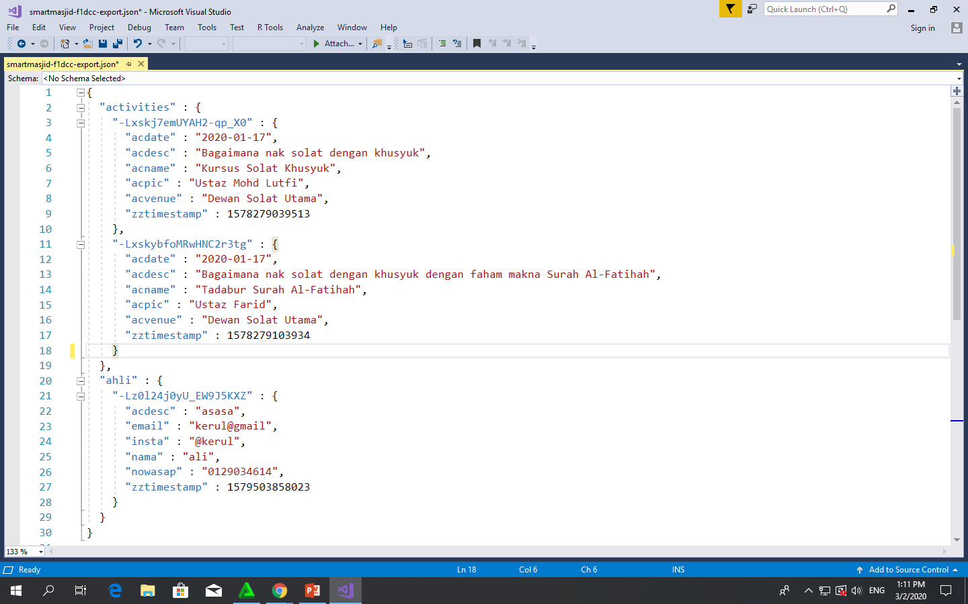
Play.google.com
JSON format example as applied in Firebase

Slide 128
IONIC + Firebase S-CRUD
Insert Record
SLIDES/NOTES
Bit.ly/ionickerul

Slide 129
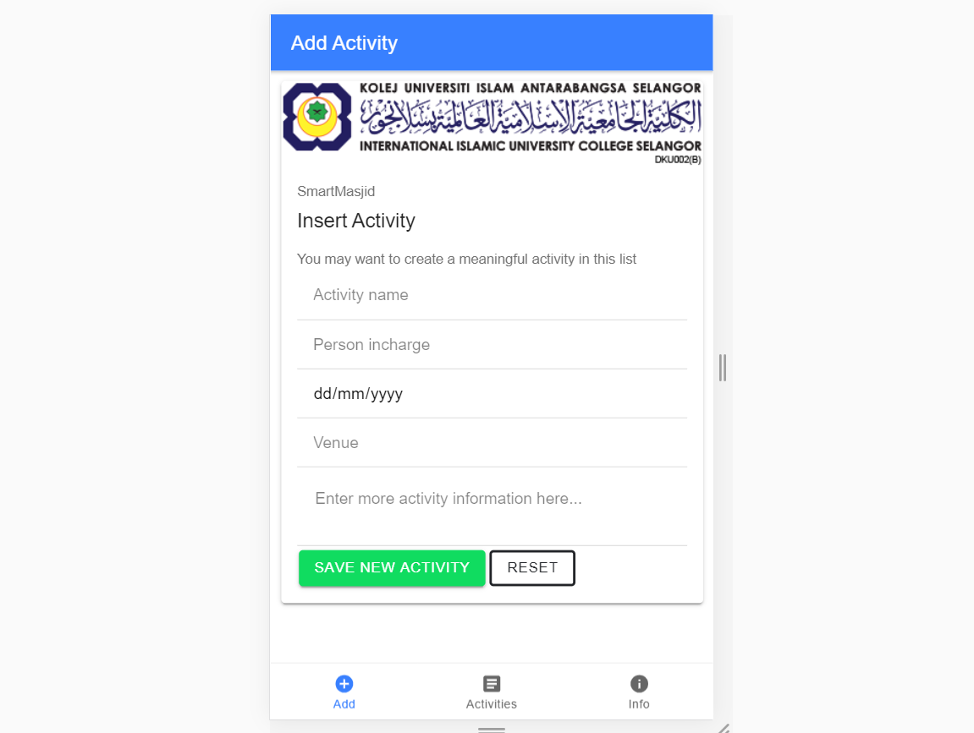
OVERVIEW

Slide 130
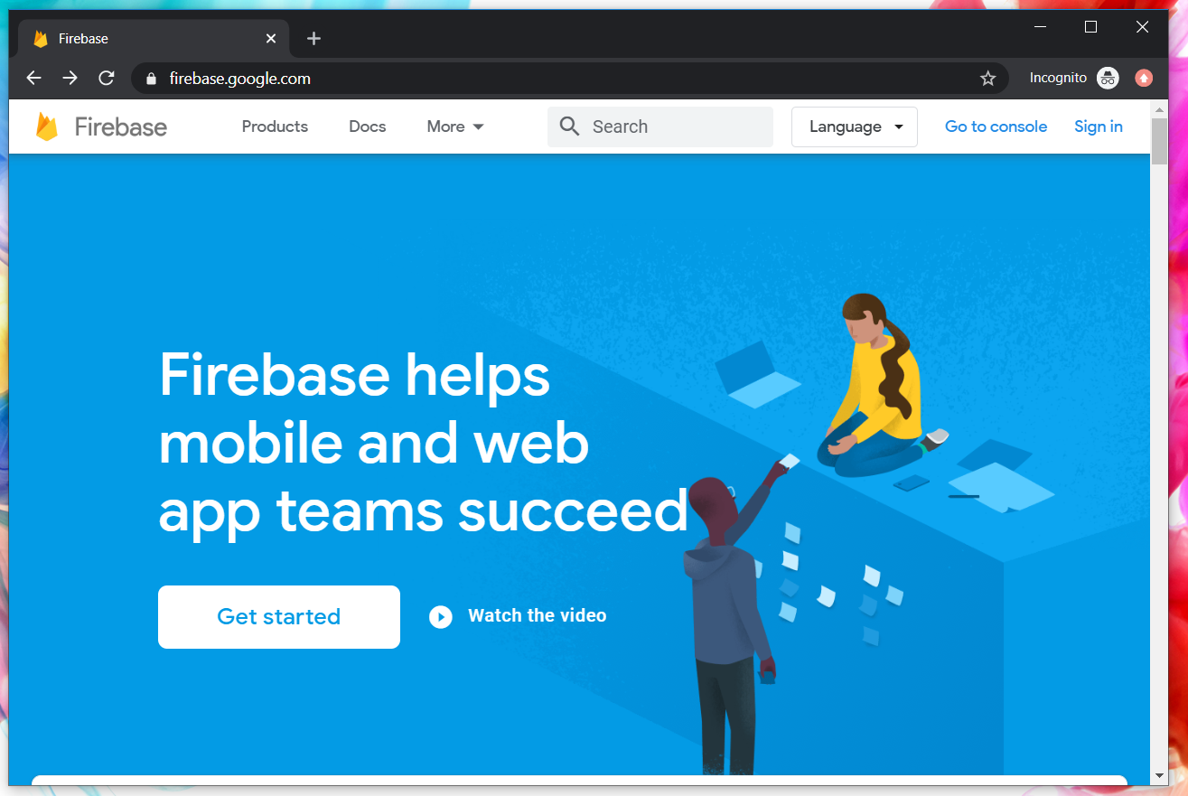
Google Firebase : Console
https://console.firebase.google.com/

Slide 131
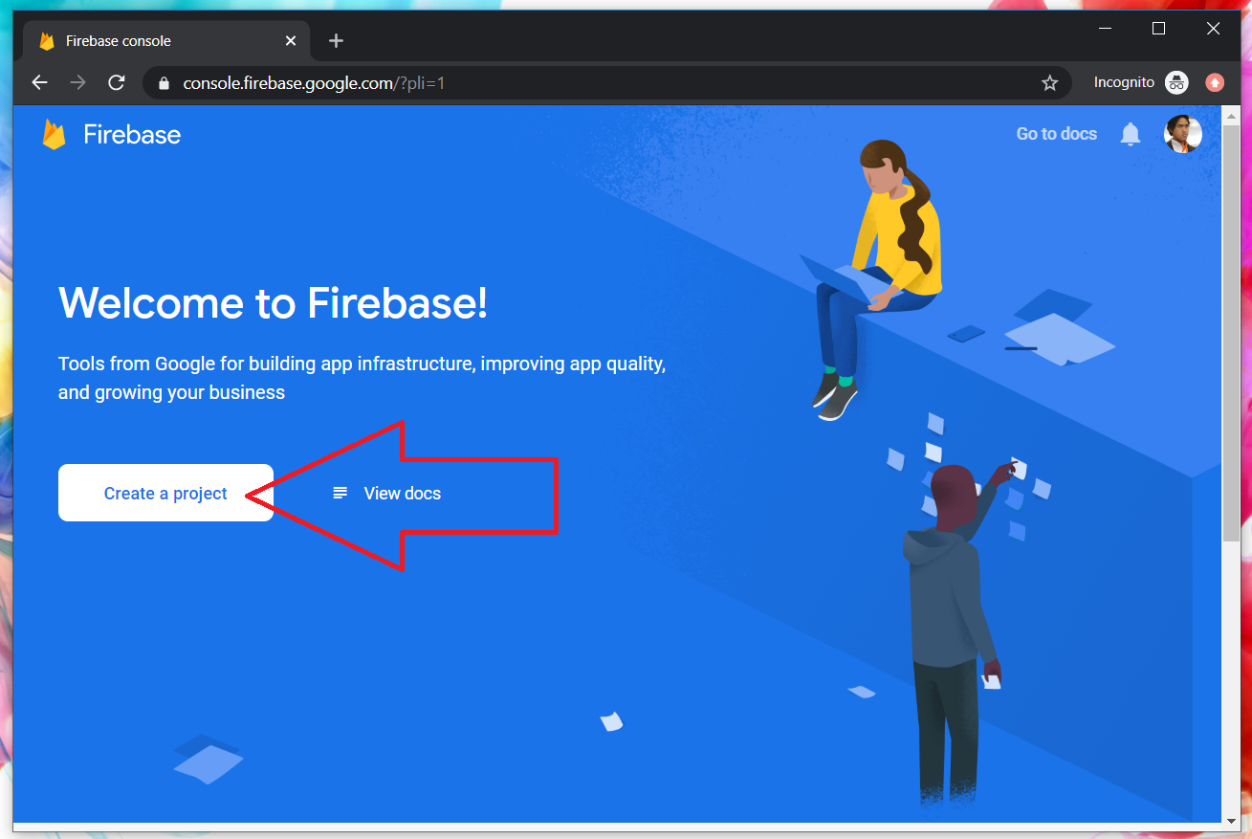
Google Firebase : Create new project

Slide 132
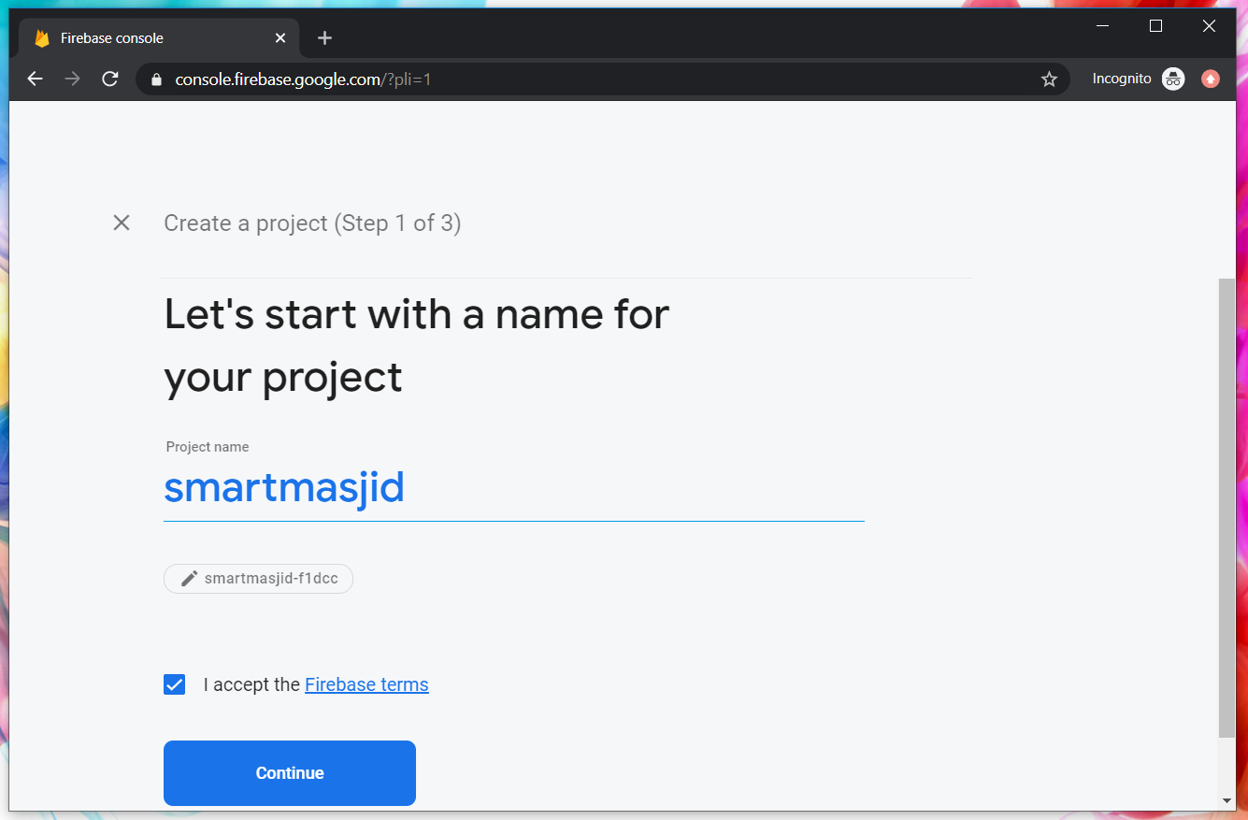
Google Firebase : Project name

Slide 133
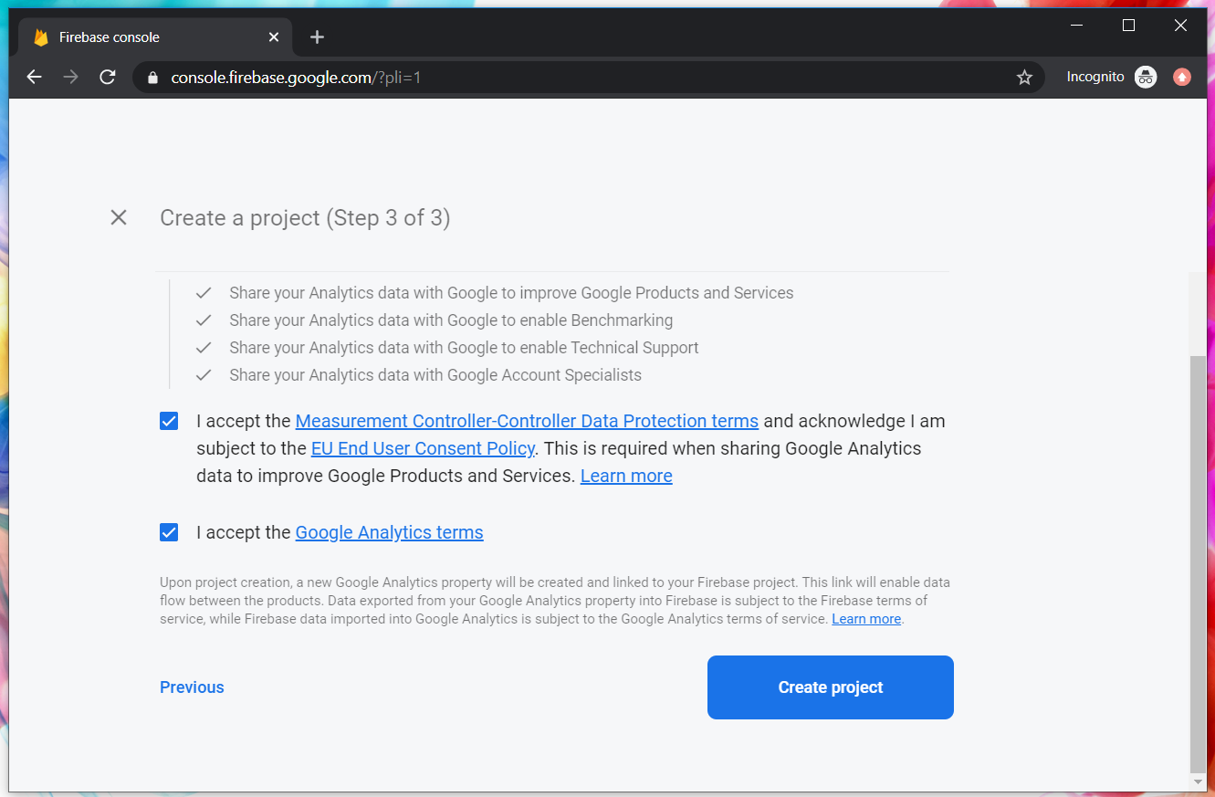
Google Firebase : Accept T&C

Slide 134
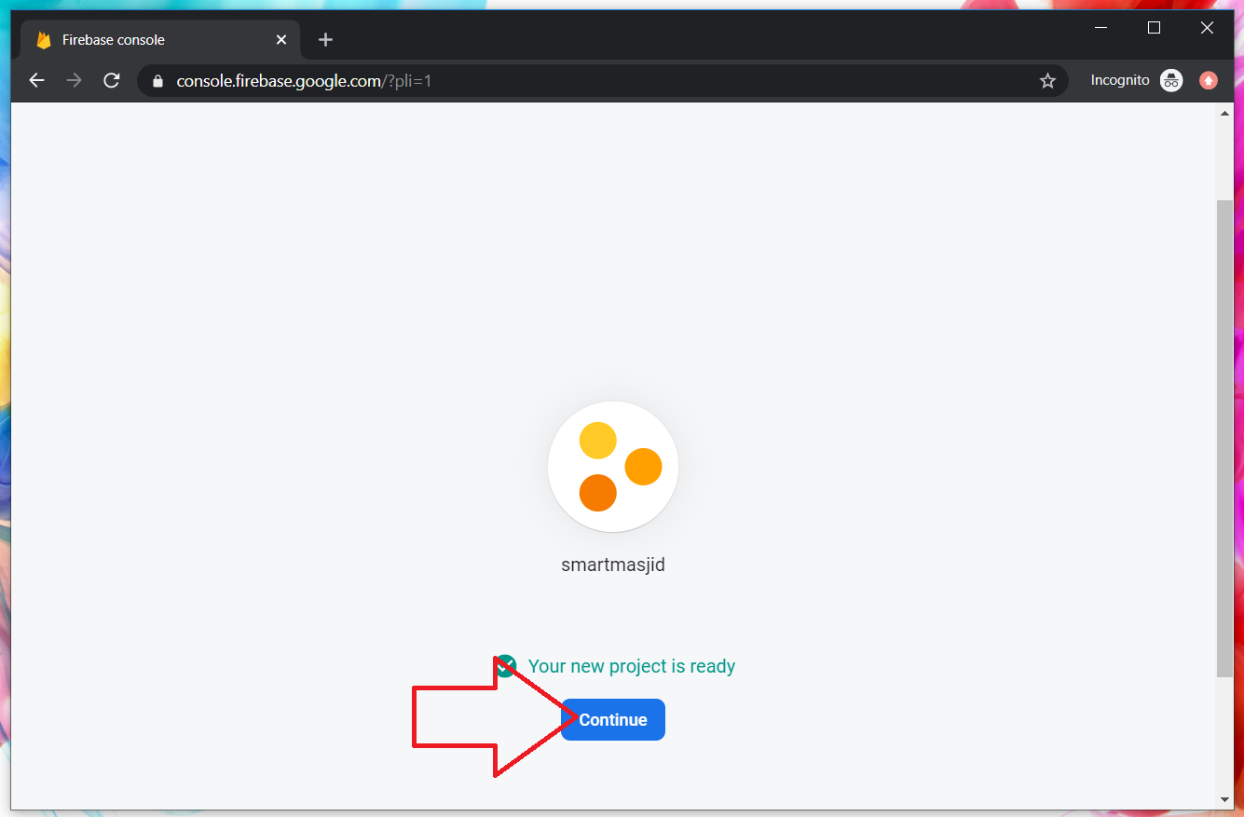
Google Firebase : Project ready and continue

Slide 135

Google Firebase : Realtime database

Slide 136

Google Firebase : Enable test mode

Slide 137

Google Firebase : get key

Slide 138

Google Firebase : project nickname

Slide 139

Google Firebase : select copy Firebase security token

Slide 140
IONIC : Create new Ionic project with Tabs
D:\>npm install -g ionic cordova
D:\>ionic start ionmasjid tabs
D:\ionmasjid>npm install firebase @angular/fire
D:\ionmasjid>ionic g service service/firebase

Slide 141
IONIC : environment.ts
Provide the Google Firebase token in environment.ts

Slide 142

IONIC : environment.ts

Slide 143
IONIC : app.module.ts
Provide the Google Firebase additional module in app.module.ts

Slide 144

IONIC : app.module.ts

Slide 145
IONIC : service/firebase.ts
Insert record process to Firebase in service

Slide 146

IONIC : service/firebase.ts

Slide 147

IONIC : service/firebase.ts add function createEntry

Slide 148

IONIC : tab1.page.html

Slide 149

IONIC : tab1.page.html

Slide 150

IONIC : tab1.page.html [(ngModel)]

Slide 151
IONIC : tab1.page.ts
Capture record data from ngModel input, and send to FirebaseService

Slide 152

IONIC : tab1.page.ts

Slide 153
IONIC : tab1.page.ts
createActivity function to send record to FirebaseService

Slide 154

IONIC : tab1.page.ts …continued

Slide 155

IONIC : to test, run ionic serve

Slide 156

FIREBASE : to view records

Slide 157
Complete code GITHUB
https://github.com/khirulnizam/ionmasjid

Slide 158
IONIC + Firebase S-CRUD
Select Records
SLIDES/NOTES
Bit.ly/ionickerul

Slide 159

OVERVIEW

Slide 160
IONIC : Create new Ionic project with Tabs
D:\>npm install -g ionic cordova
D:\>ionic start ionmasjid tabs
D:\ionmasjid>npm install firebase @angular/fire
D:\ionmasjid>ionic g service service/firebase

Slide 161
IONIC : environment.ts
Provide the Google Firebase token in environment.ts

Slide 162
IONIC : environment.ts

Slide 163
IONIC : service/firebase.ts
Select record process to Firebase in service

Slide 164
IONIC : service/firebase.ts

Slide 165
IONIC : service/firebase.ts add function createEntry

Slide 166
IONIC : tab2.page.html

Slide 167

IONIC : tab2.page.html

Slide 168
IONIC : tab2.page.ts
snapshotToArray function to extract record from firebase

Slide 169

IONIC : tab2.page.ts

Slide 170

IONIC : tab2.page.ts …continued

Slide 171
IONIC : to test, run ionic serve

Slide 172
FIREBASE : to view records

Slide 173
S-CRUD – means Search, Create, Update & Delete. Search and Create have been demoed to you.
Now in group, students need to do Search and Update on a new Table named AHLI – with column nama, nomborwasap, email, and akaunInstagram.

Slide 174
Complete code GITHUB
https://github.com/khirulnizam/ionmasjid

